Slide 1



Brent Spence Bridge Corridor Project Vibration Monitoring For Adverse Effects
2026 ACEC-KY/FHWA/KYTC Partnering Conference - September 10, 2026

Slide 2


Stephanie Lechert
Historic Preservation Coordinator
Becky Gatewood
Senior Architectural Historian
Jared Bloom
Environmental Compliance Coordinator

Slide 3
Notes:
The BSB Corridor Project will construct a new double-deck companion bridge along side the existing Brent Spence Bridge at the I-71 and I-75 Ohio River crossing between Kentucky and Ohio and improve traffic flow along the roadway corridor. Most of the original environmental work for the project began back in the early 2000s, with an initial Environmental Assessment and FONSI completed in 2012 and a Supplemental Environmental Assessment and FONSI completed in 2024.

Slide 4
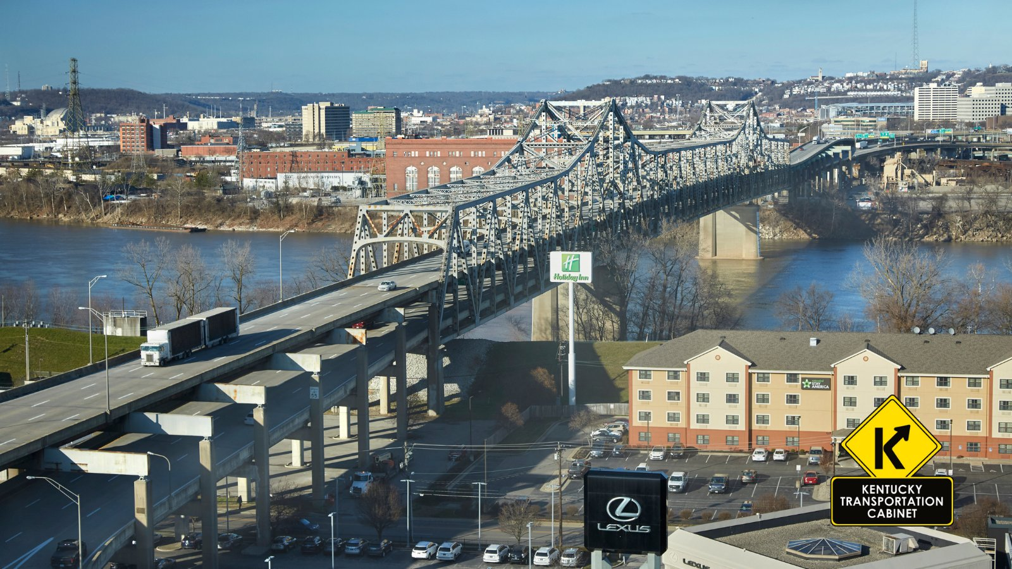
Notes:
Originally completed in 1963, the BSB is a 3-span, double-deck steel cantilever thru truss bridge named for U.S. Representative Brent Spence, who represented Kentucky’s 5th district between 1935 and 1963. The BSB was originally designed to handle 80,000 vehicles daily, but the bridge now carries more than double its intended capacity.

Slide 5

Notes:
New companion bridge will take the through traffic on I71/75 and the existing Brent Spence Bridge will host the local traffic going into Covington, KY and Cincinnati, OH respectively. As part of the 2012 environmental assessment process, the Section 106 evaluation determined the project would have an Adverse Effect to the Lewisburg Historic District due to the proposed taking of multiple contributing historic properties within the district. During subsequent revisions to the project plans, the number of contributing historic properties has been reduced significantly, but the Adverse Effect to Lewisburg remains.

Slide 6
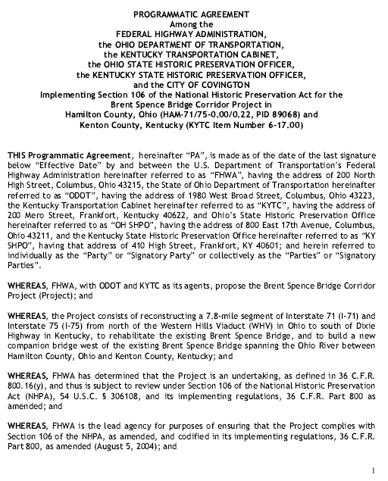
Kentucky Cultural Resource
Mitigation Commitments
Vibration Monitoring for historic properties within the Lewisburg Historic District
State-level Documentation
Façade Grant Program for resources within the Lewisburg Historic District
Notes:
Since there was an Adverse Effect determination, mitigation commitments were necessary. The Programmatic Agreement originally started as a Memorandum of Agreement in 2012 and updated in 2023 as a bi-state PA for legal reasons.
3 mitigation commitments were decided upon for the Kentucky side of the project.

Slide 7
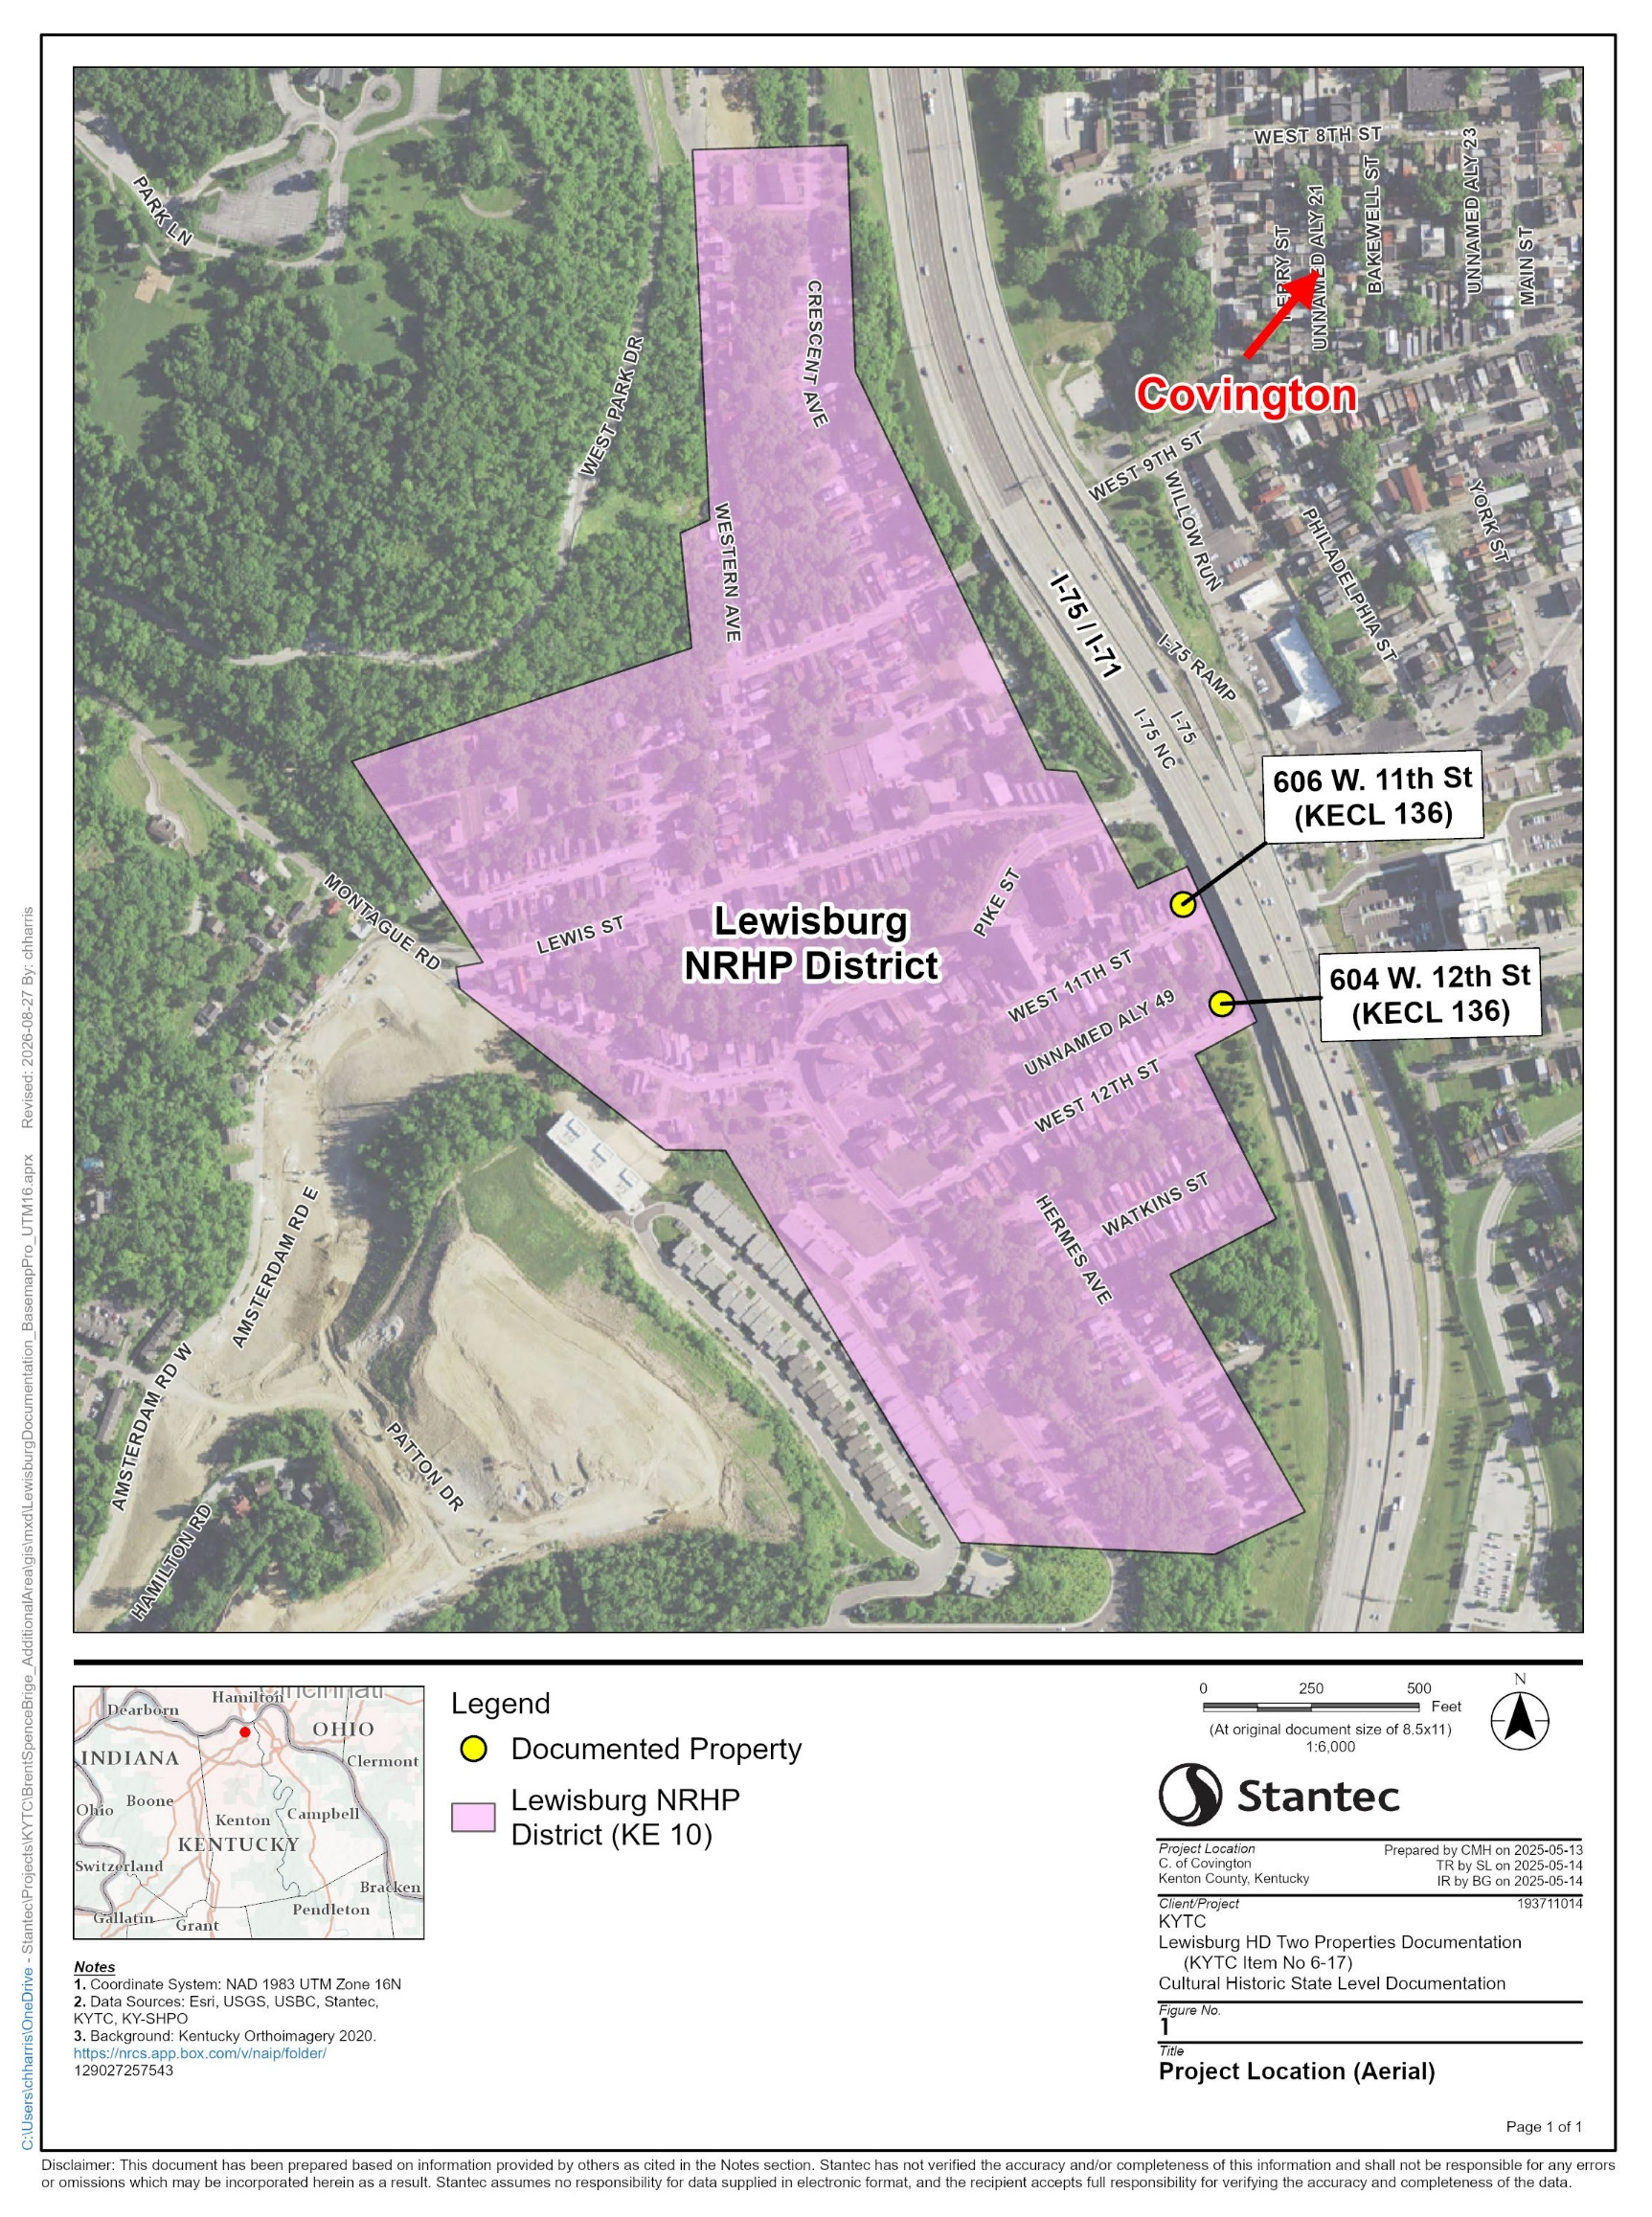
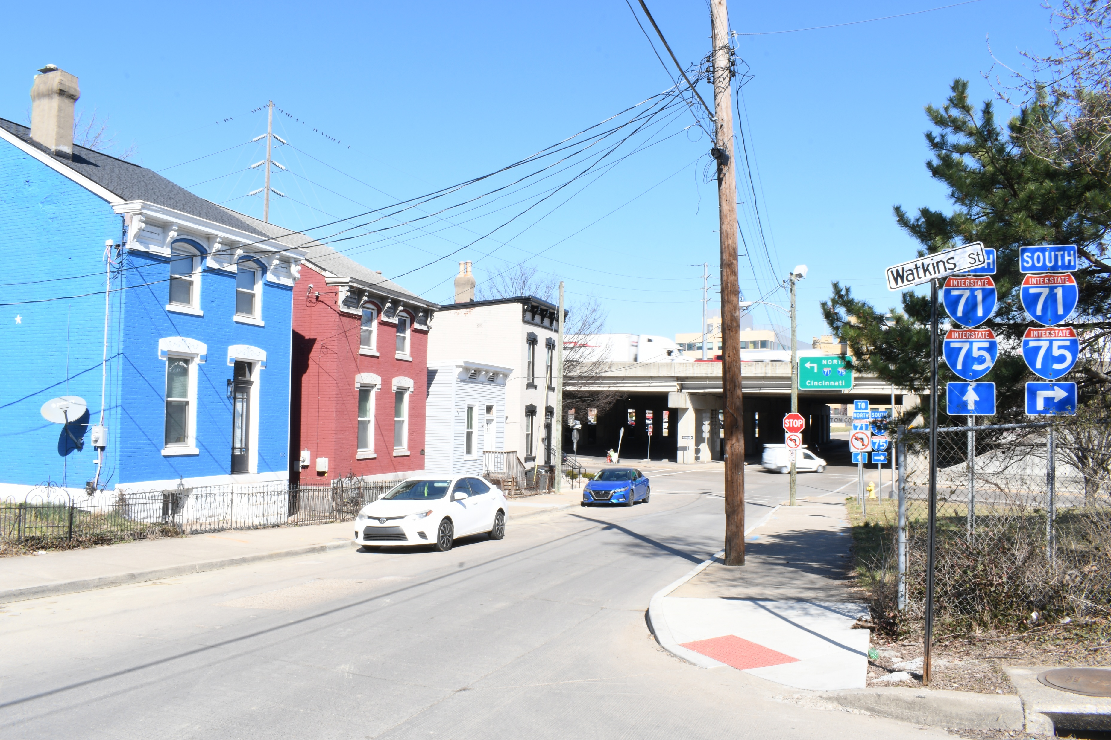
NRHP-Listed Lewisburg Historic District
Lewisburg National Register of Historic Places District
  Listed 1993
  Listed under Criteria A and C
  Period of significance for the District is 1840-1947
Notes:
In 2022, Cardno, now Stantec was contracted by KYTC to complete a Cultural Historic Survey for the Brent Spence Bridge Renewal Project. Stantec’s architectural history team surveyed the project Area of Potential Effects, which included portions of the NRHP-listed Lewisburg Historic District. This district is directly adjacent to I75/I71 and southwest of Covington. Lewisburg was developed as a working class neighborhood with small lots and modest residences as well as churches and businesses and also industries where residents were employed. The District (Listed 1993; NRIS 93001165) is characterized by narrow lot sizes and an urban appearance where setback from the street is typically minimal. The District is listed under Criterion A within the Area of Significance of Community Planning and Development with local significance within the context of Suburban Growth in Covington. The District is also listed under Criterion C for containing a “solid inventory of locally typical working and middle class domestic architecture of the second half of the nineteenth century and the early twentieth century…”

Slide 8

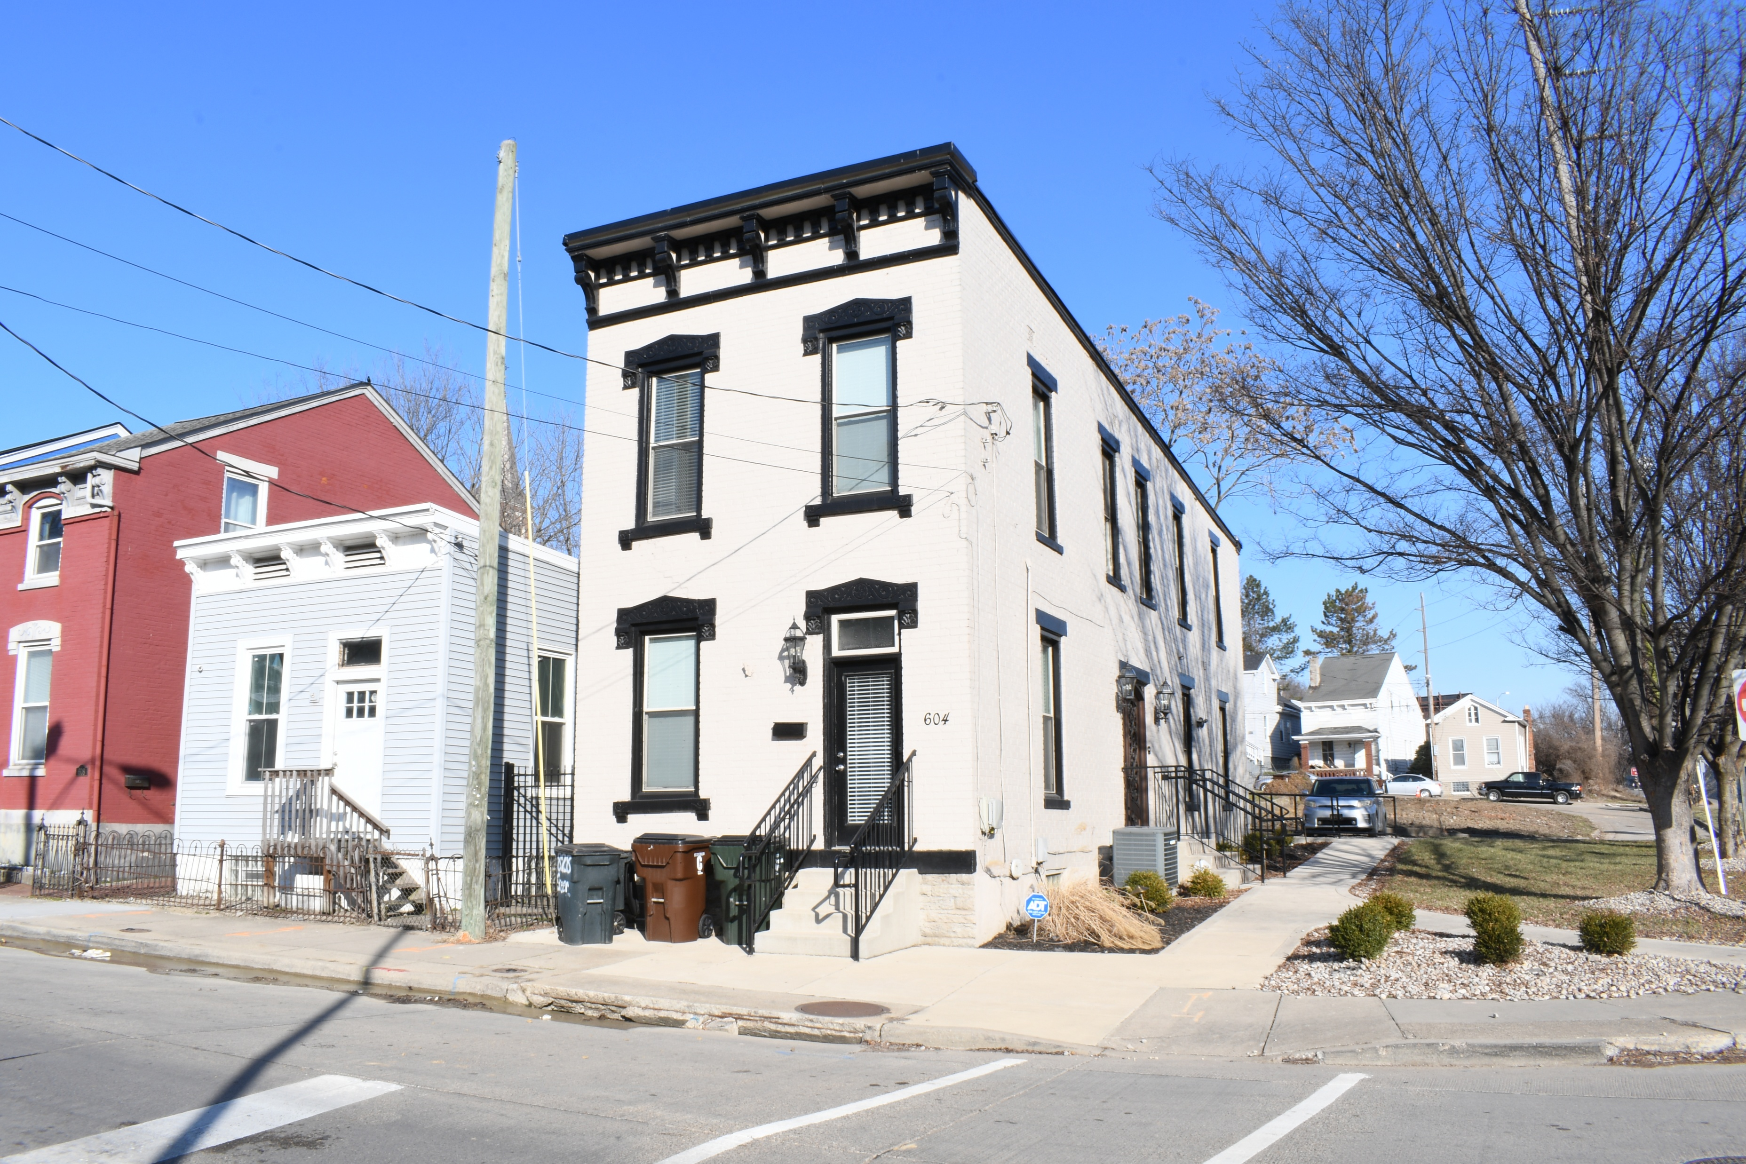
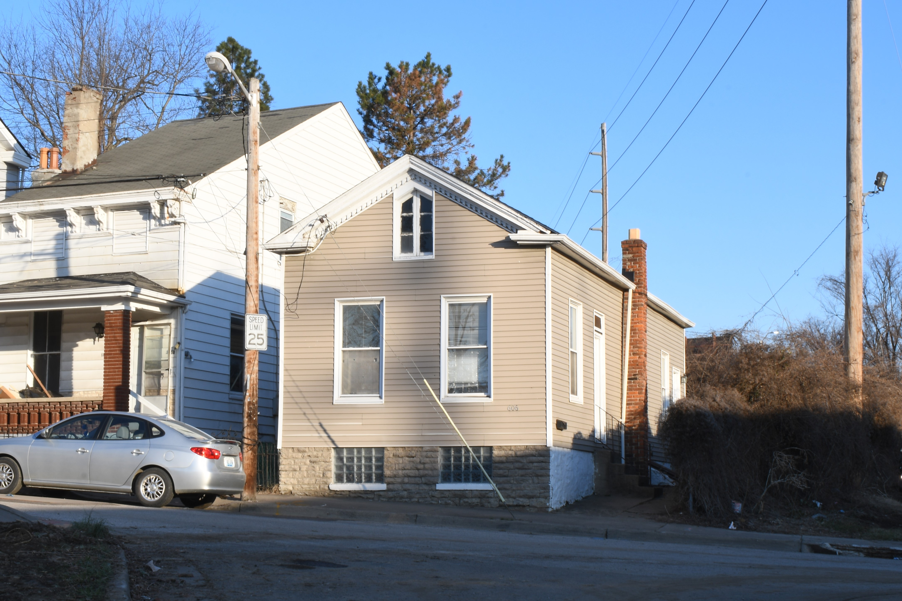
604 West 12th Street, Willner House, Lewisburg
Circa 1890 KHC# KECL 136
606 West 11th Street, Schaffner House, Lewisburg
Circa 1870 KHC# KECL 115
Two residential buildings within and contributing to the NRHP-listed district were found in an area required for right-of-way as part of the Brent Spence Bridge Renewal Project. These two buildings were slated for demolition.
Programmatic Agreement (PA) executed in 2023
  Stipulated: State Level Documentation (Stantec)
            Development of a Façade Grant Program (City of Covington)
            Vibration testing to avoid damage to historic properties (KYTC)
Notes:
Two contributing residential buildings within the NRHP-listed district were found in an area required for right-of-way as part of the Brent Spence Bridge Renewal Project. These two buildings were slated for demolition, and it was determined that as a result the project would have an adverse effect on the historic district. In 2023, a PA between FHWA, KYTC, the Kentucky Heritage Council/KY SHPO, the Ohio Department of Transportation, the Ohio Historic Preservation Office/OH SHPO, and the City of Covington, Kentucky was executed. This PA stipulated that State Level Documentation be completed for the two buildings prior to demolition to partially mitigate the adverse effect to the Lewisburg Historic District. Stantec was contracted by KYTC to create separate documentation reports for each building. This documentation included a Kentucky Historic Resources Individual Survey Form, a historic context, and digital photography. In addition, documentation included measured floor plans, primary and secondary elevation drawings, and isometric renderings. The PA included additional commitments that were required to be fulfilled, such as the development of a Façade Grant Program for the residential and commercial properties within the District, and vibration testing to avoid damage to historic properties.

Slide 9
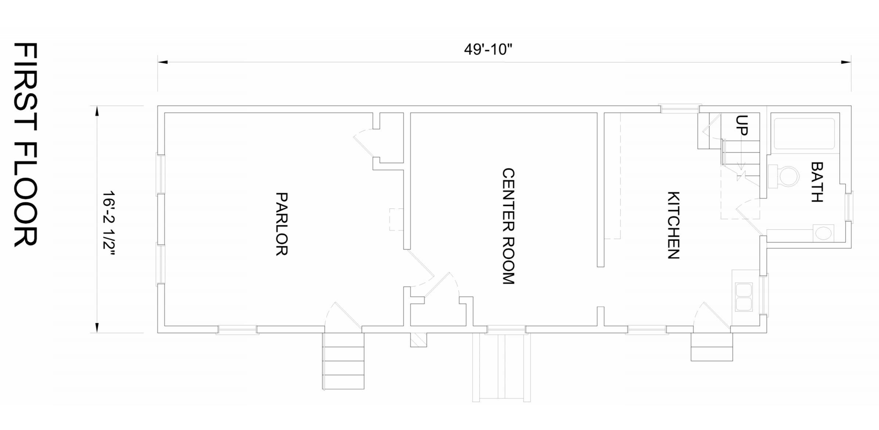

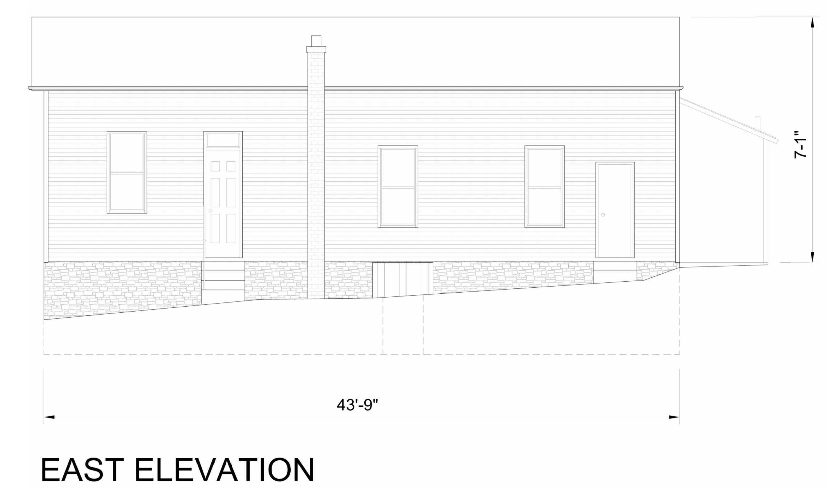
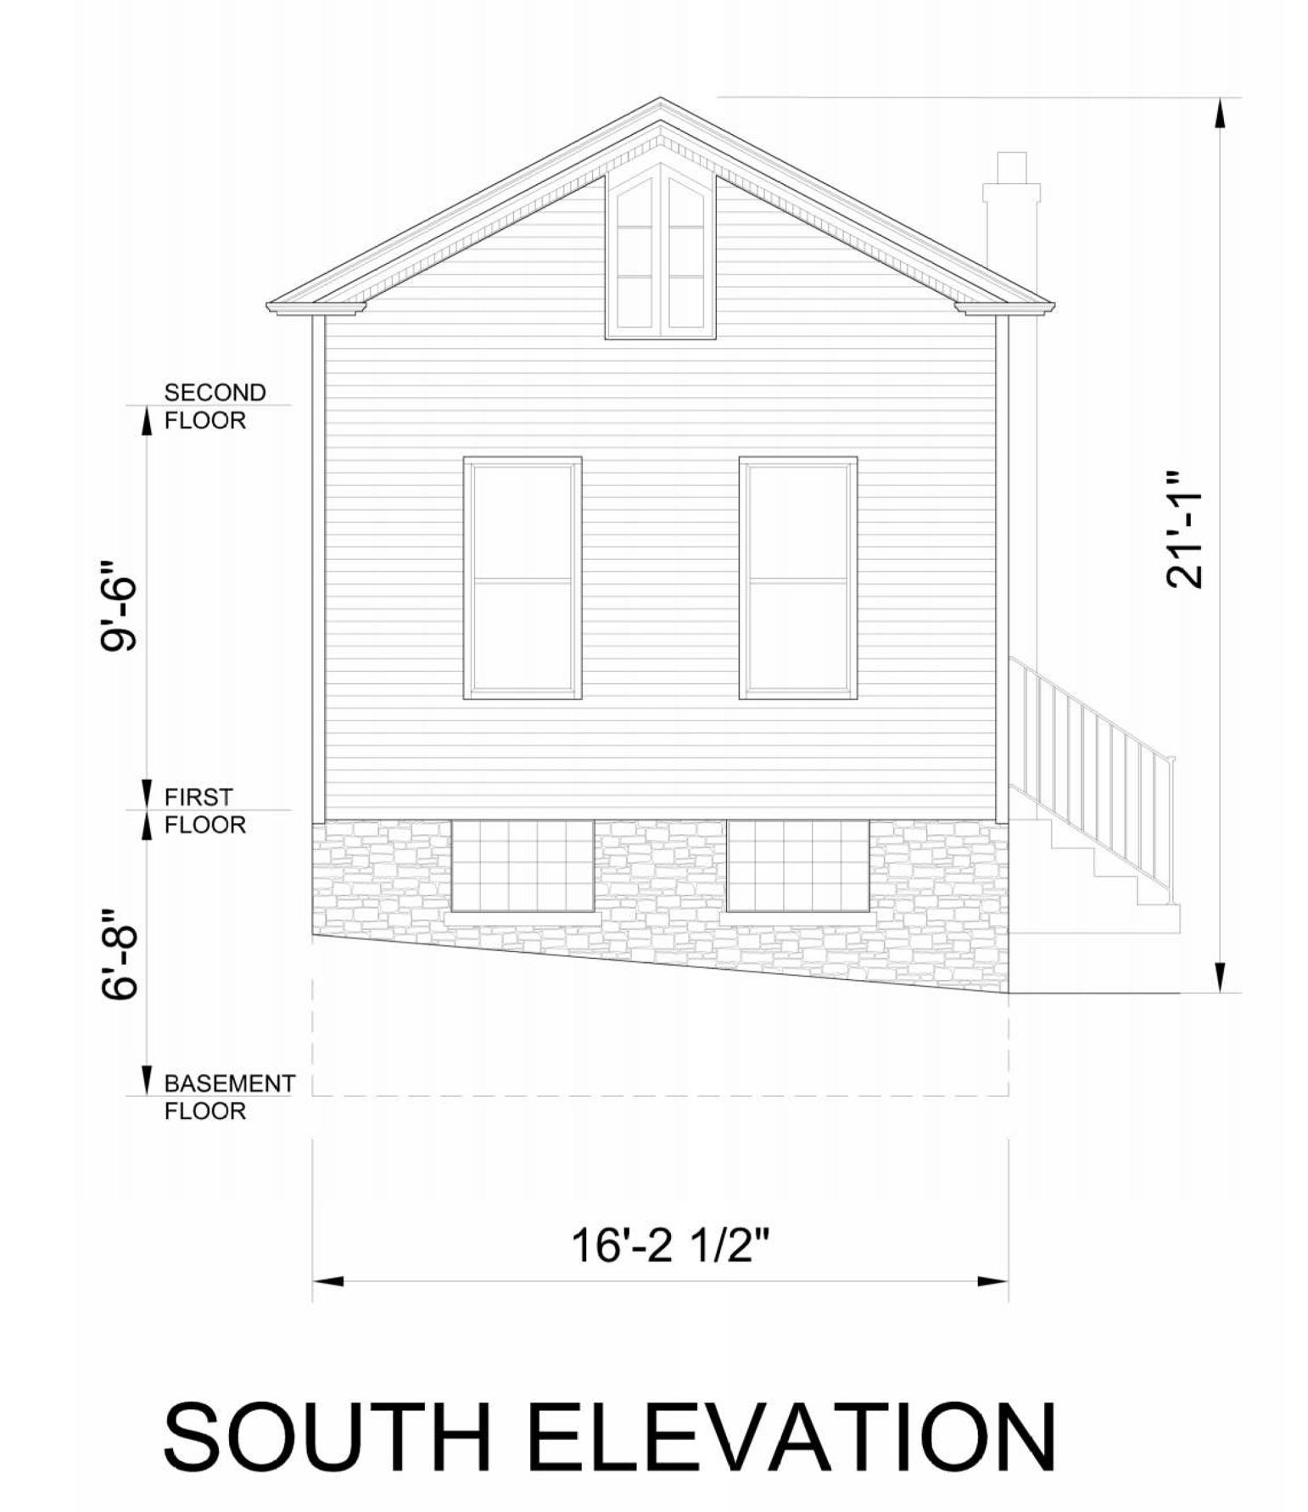
606 West 11th Street, Schaffner House, Lewisburg
Circa 1870 KHC# KECL 115
Notes:
In 2025, Stantec’s architectural history team returned to the project area to measure the interior of both buildings. Photographs, measurements, and notes were used to create the floor plans for the building. Exterior recordation of the house was possible through the use of drone scanning, which enabled the creation of a three-dimensional model of the building. This model successfully reproduced each elevation of the house and allowed for the creation of high quality scaled elevations created in two-dimensional profile.
606 11th Street – German-American household, working-to-middle class, Northern Ky Townhouse (side entry midway along side elevation

Slide 10
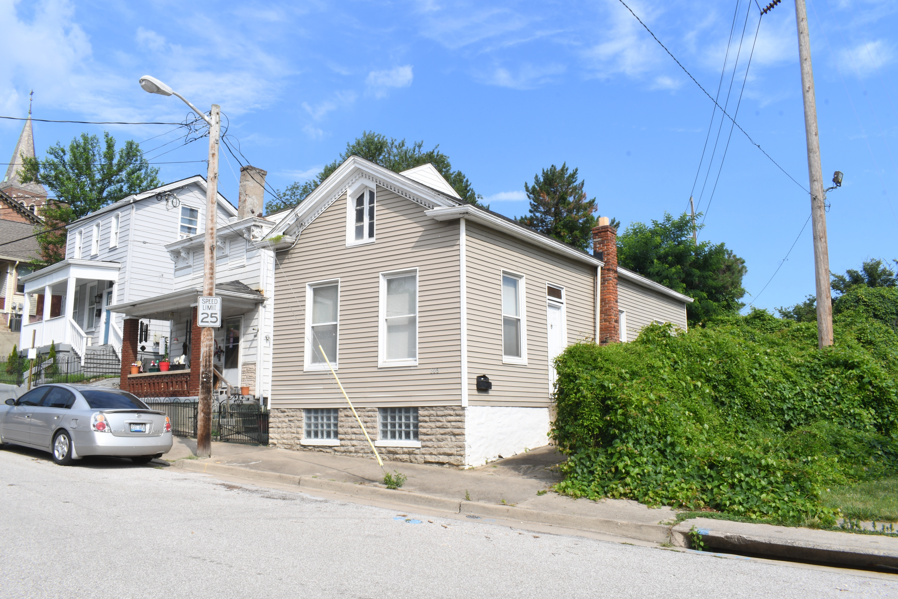
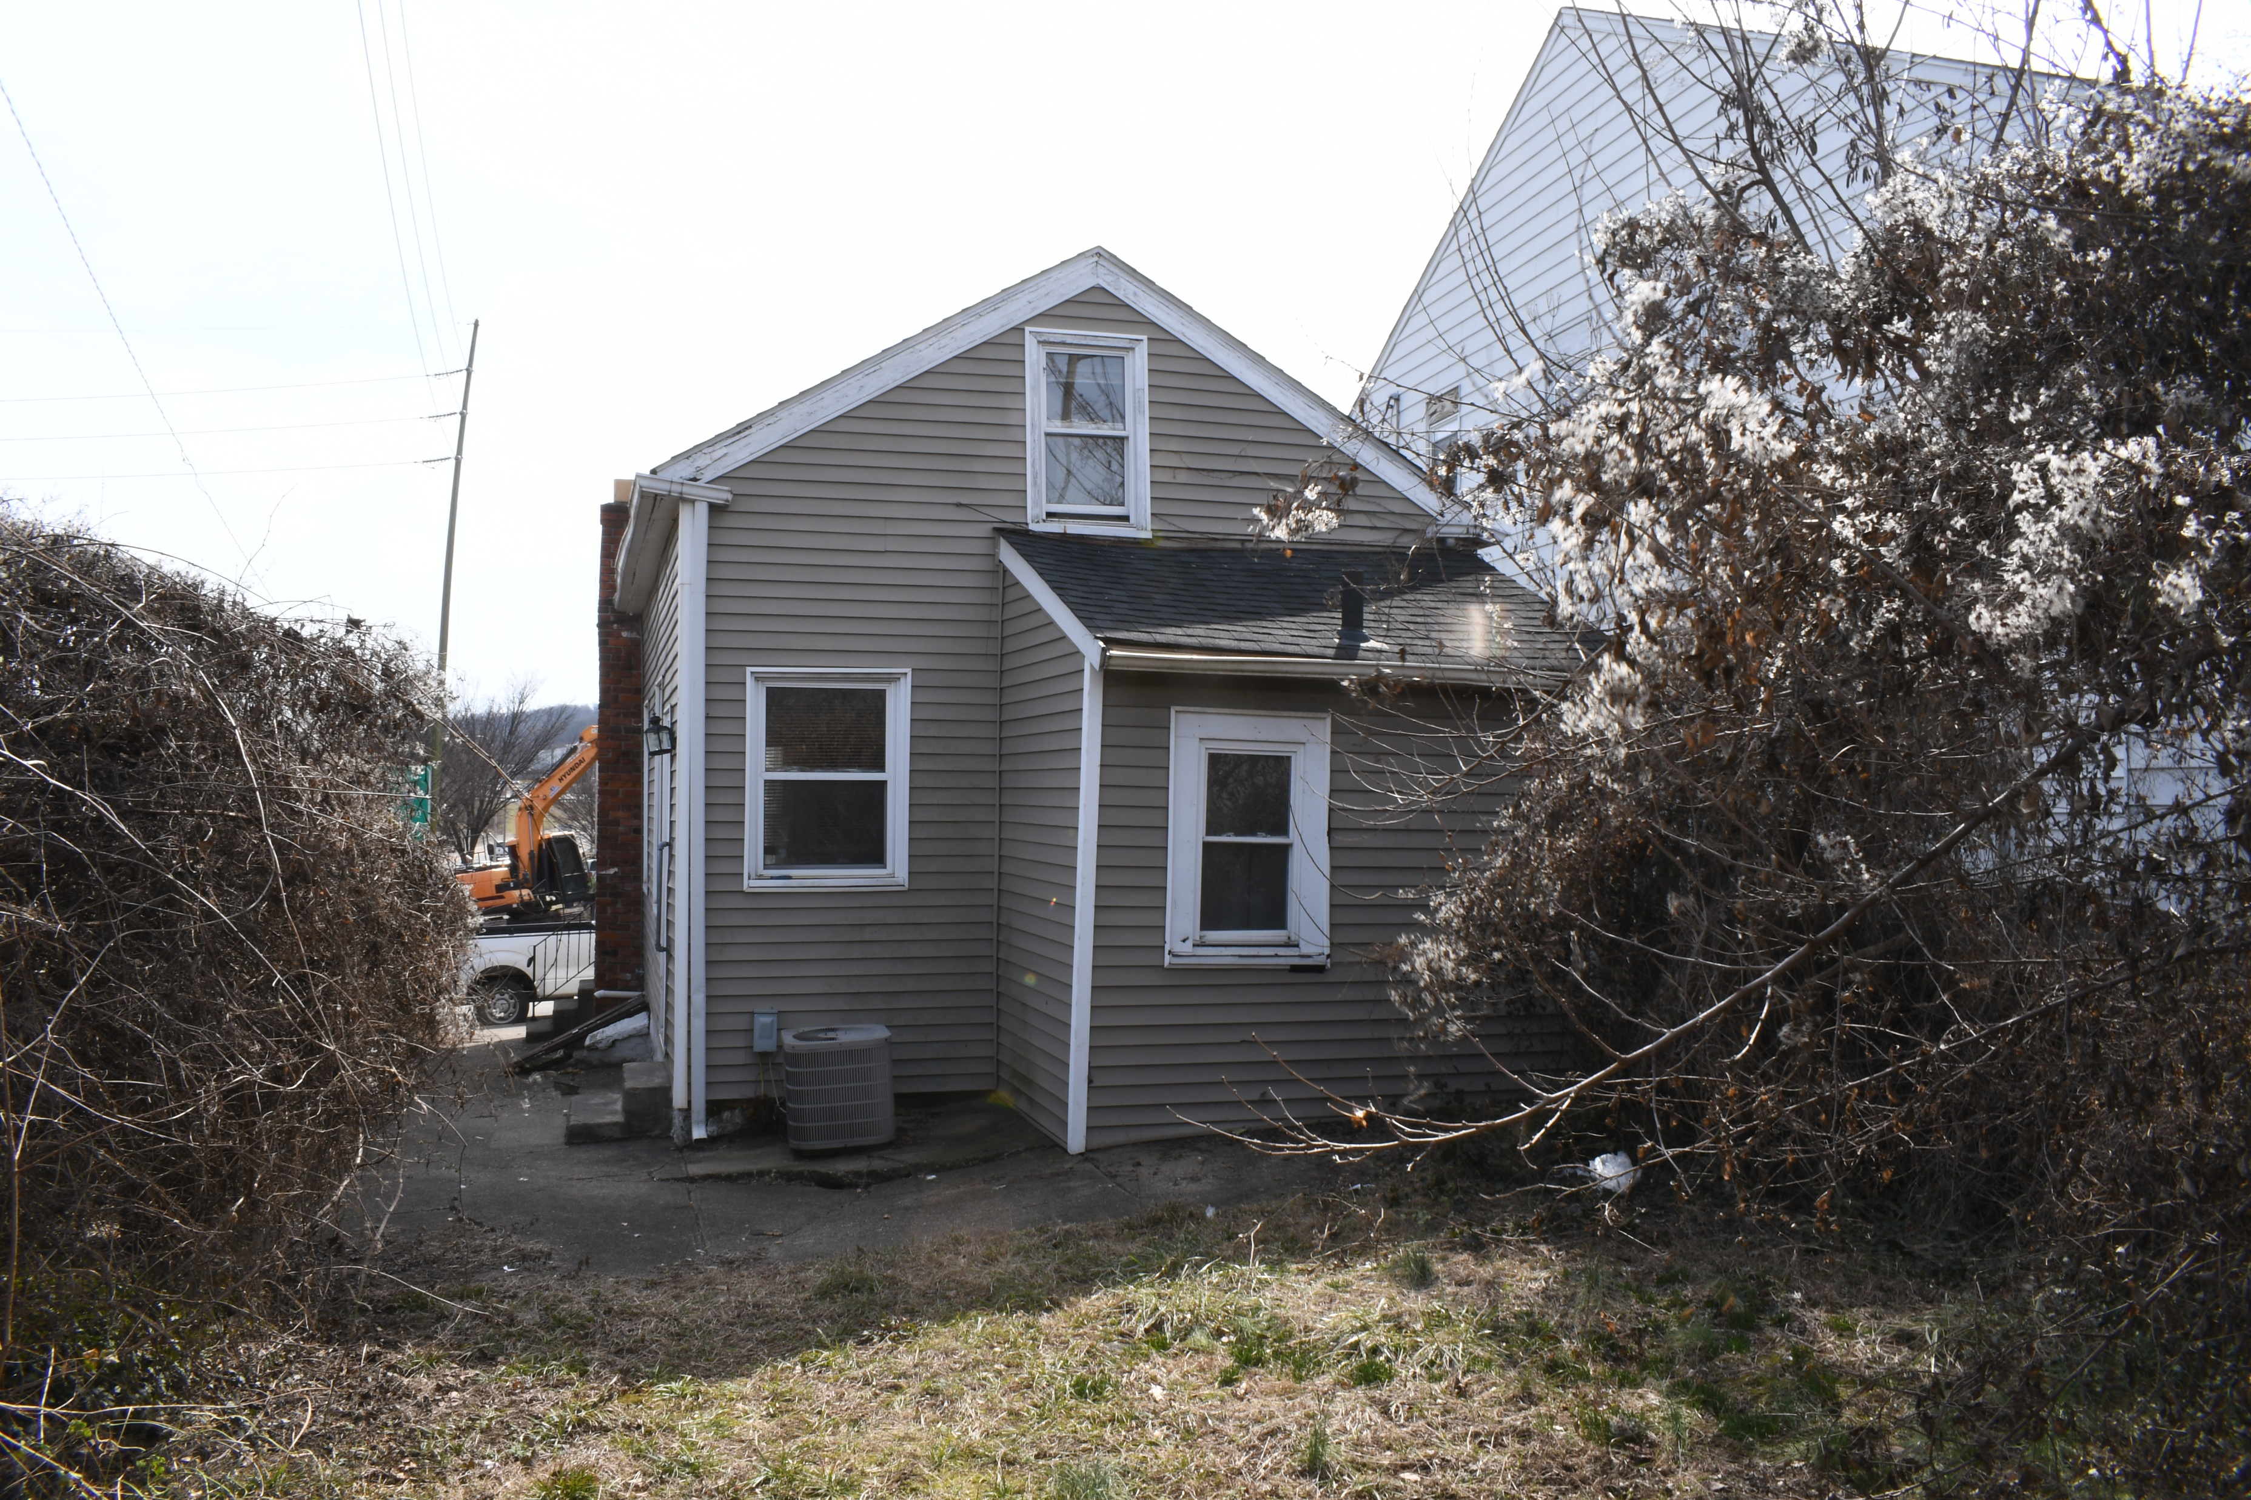
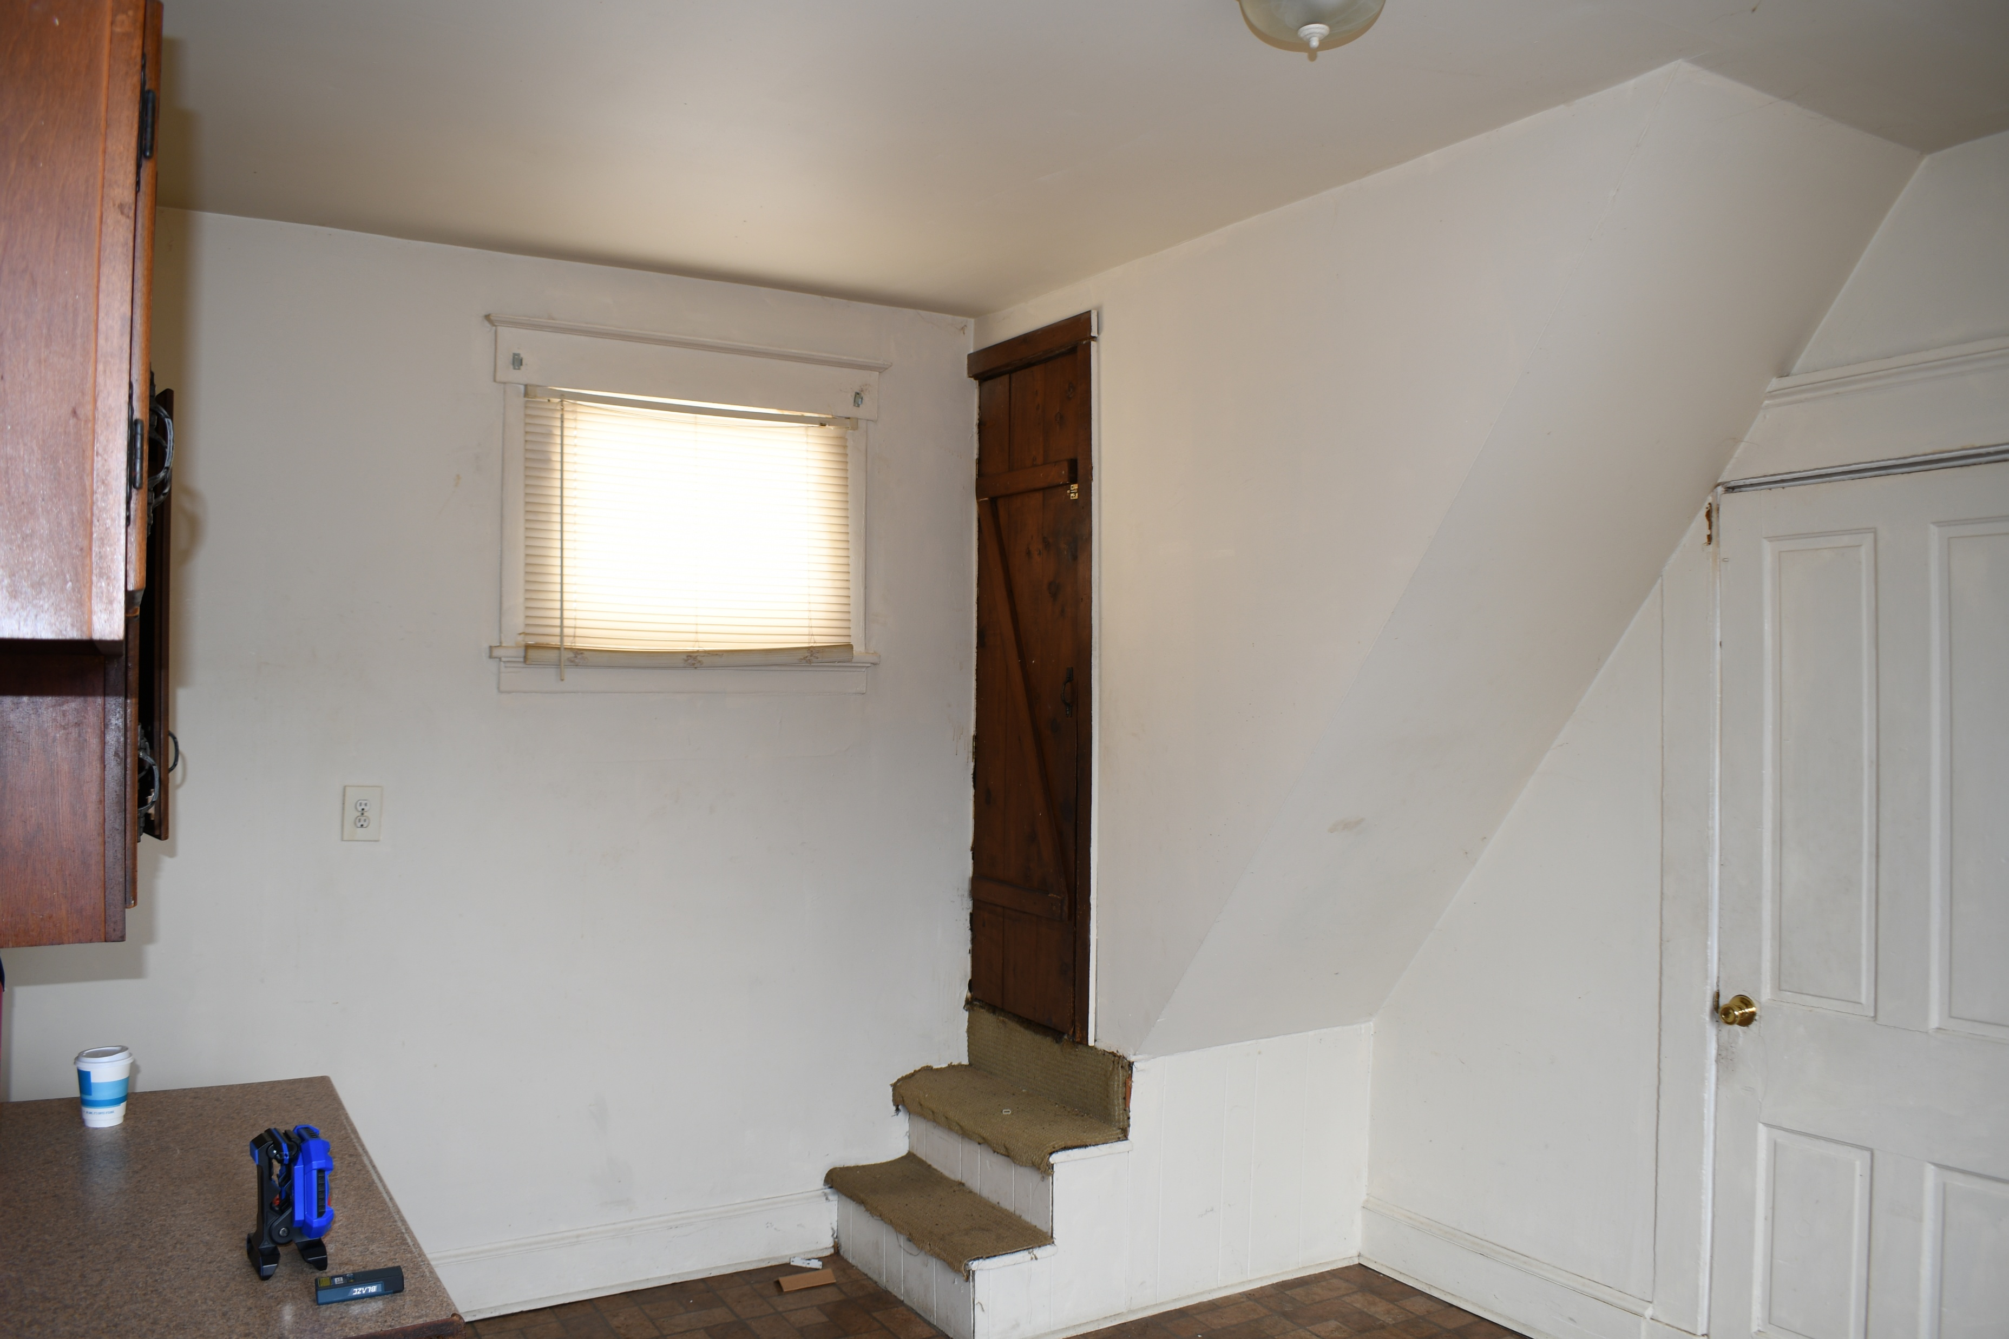
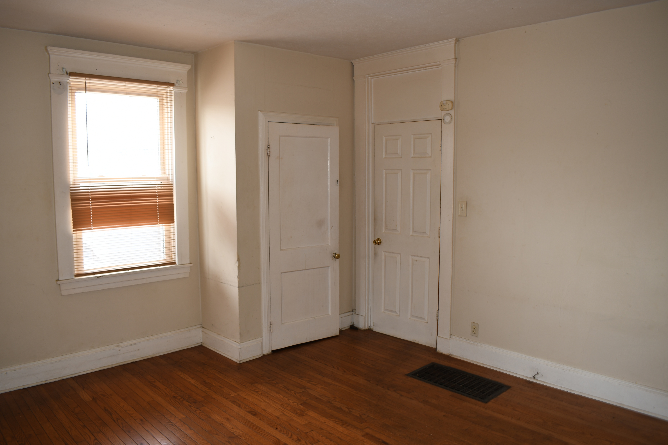

Slide 11
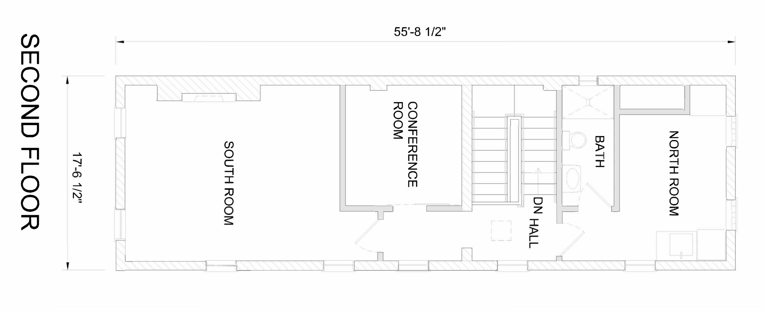
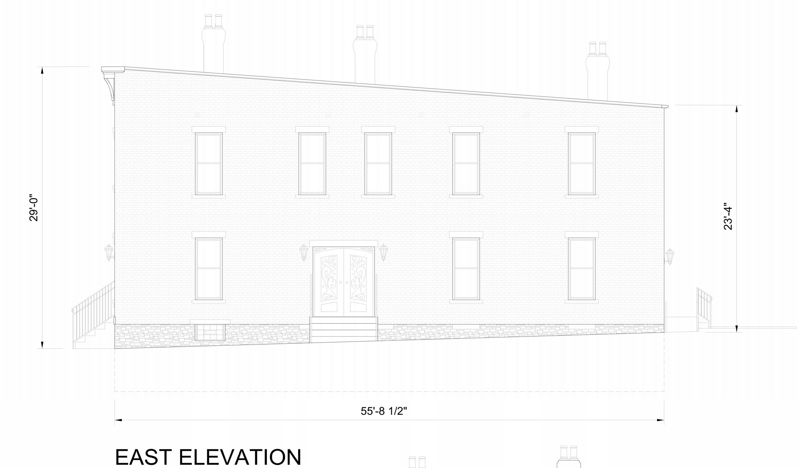
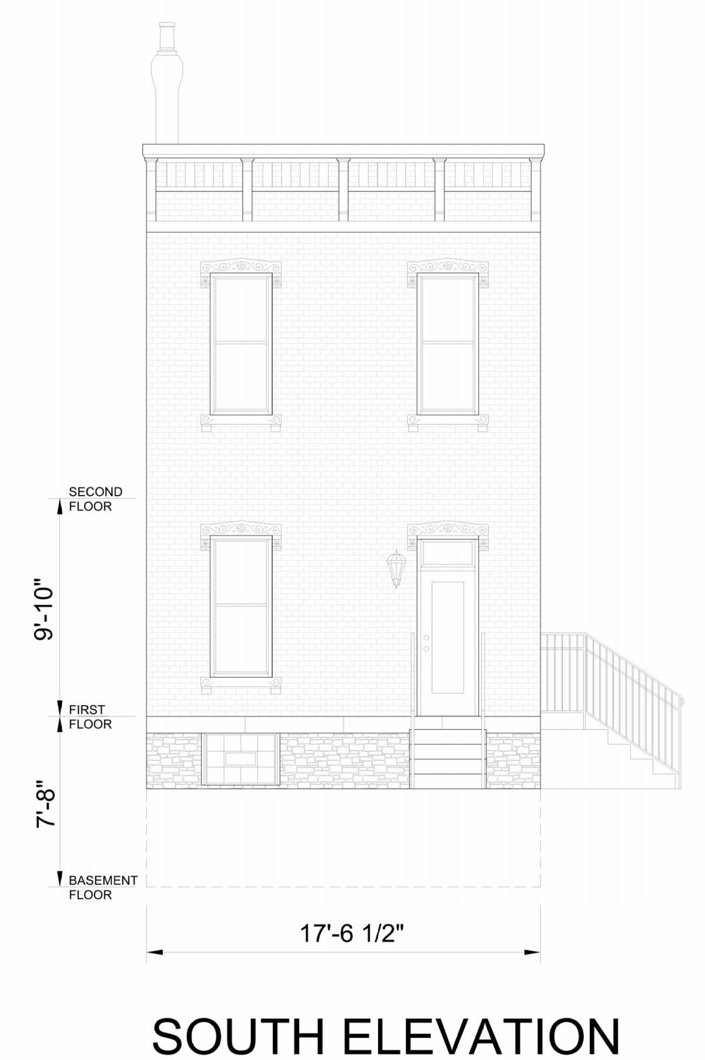
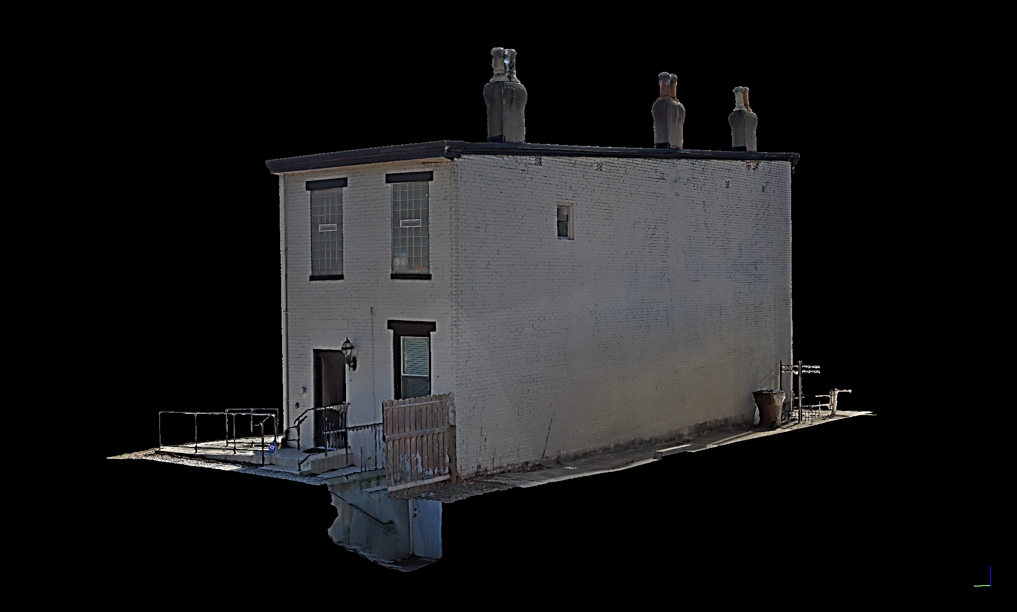
604 West 12th Street, Willner House, Lewisburg
Circa 1890 KHC# KECL 136
Notes:
These isometric drawings can also be used to create a rotating three dimensional image. This image of the building can be linked to a QR Code and reside on a website for viewers to experience the building in three dimension, with the capability to rotate the image. 604 12th Street – German-American household, working-to-middle class, Italianate (prevalent style in the district)

Slide 12

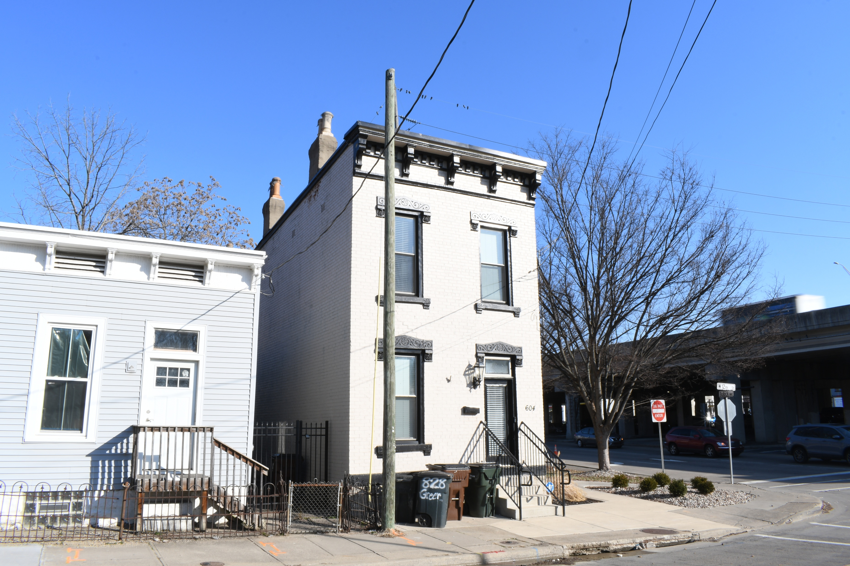
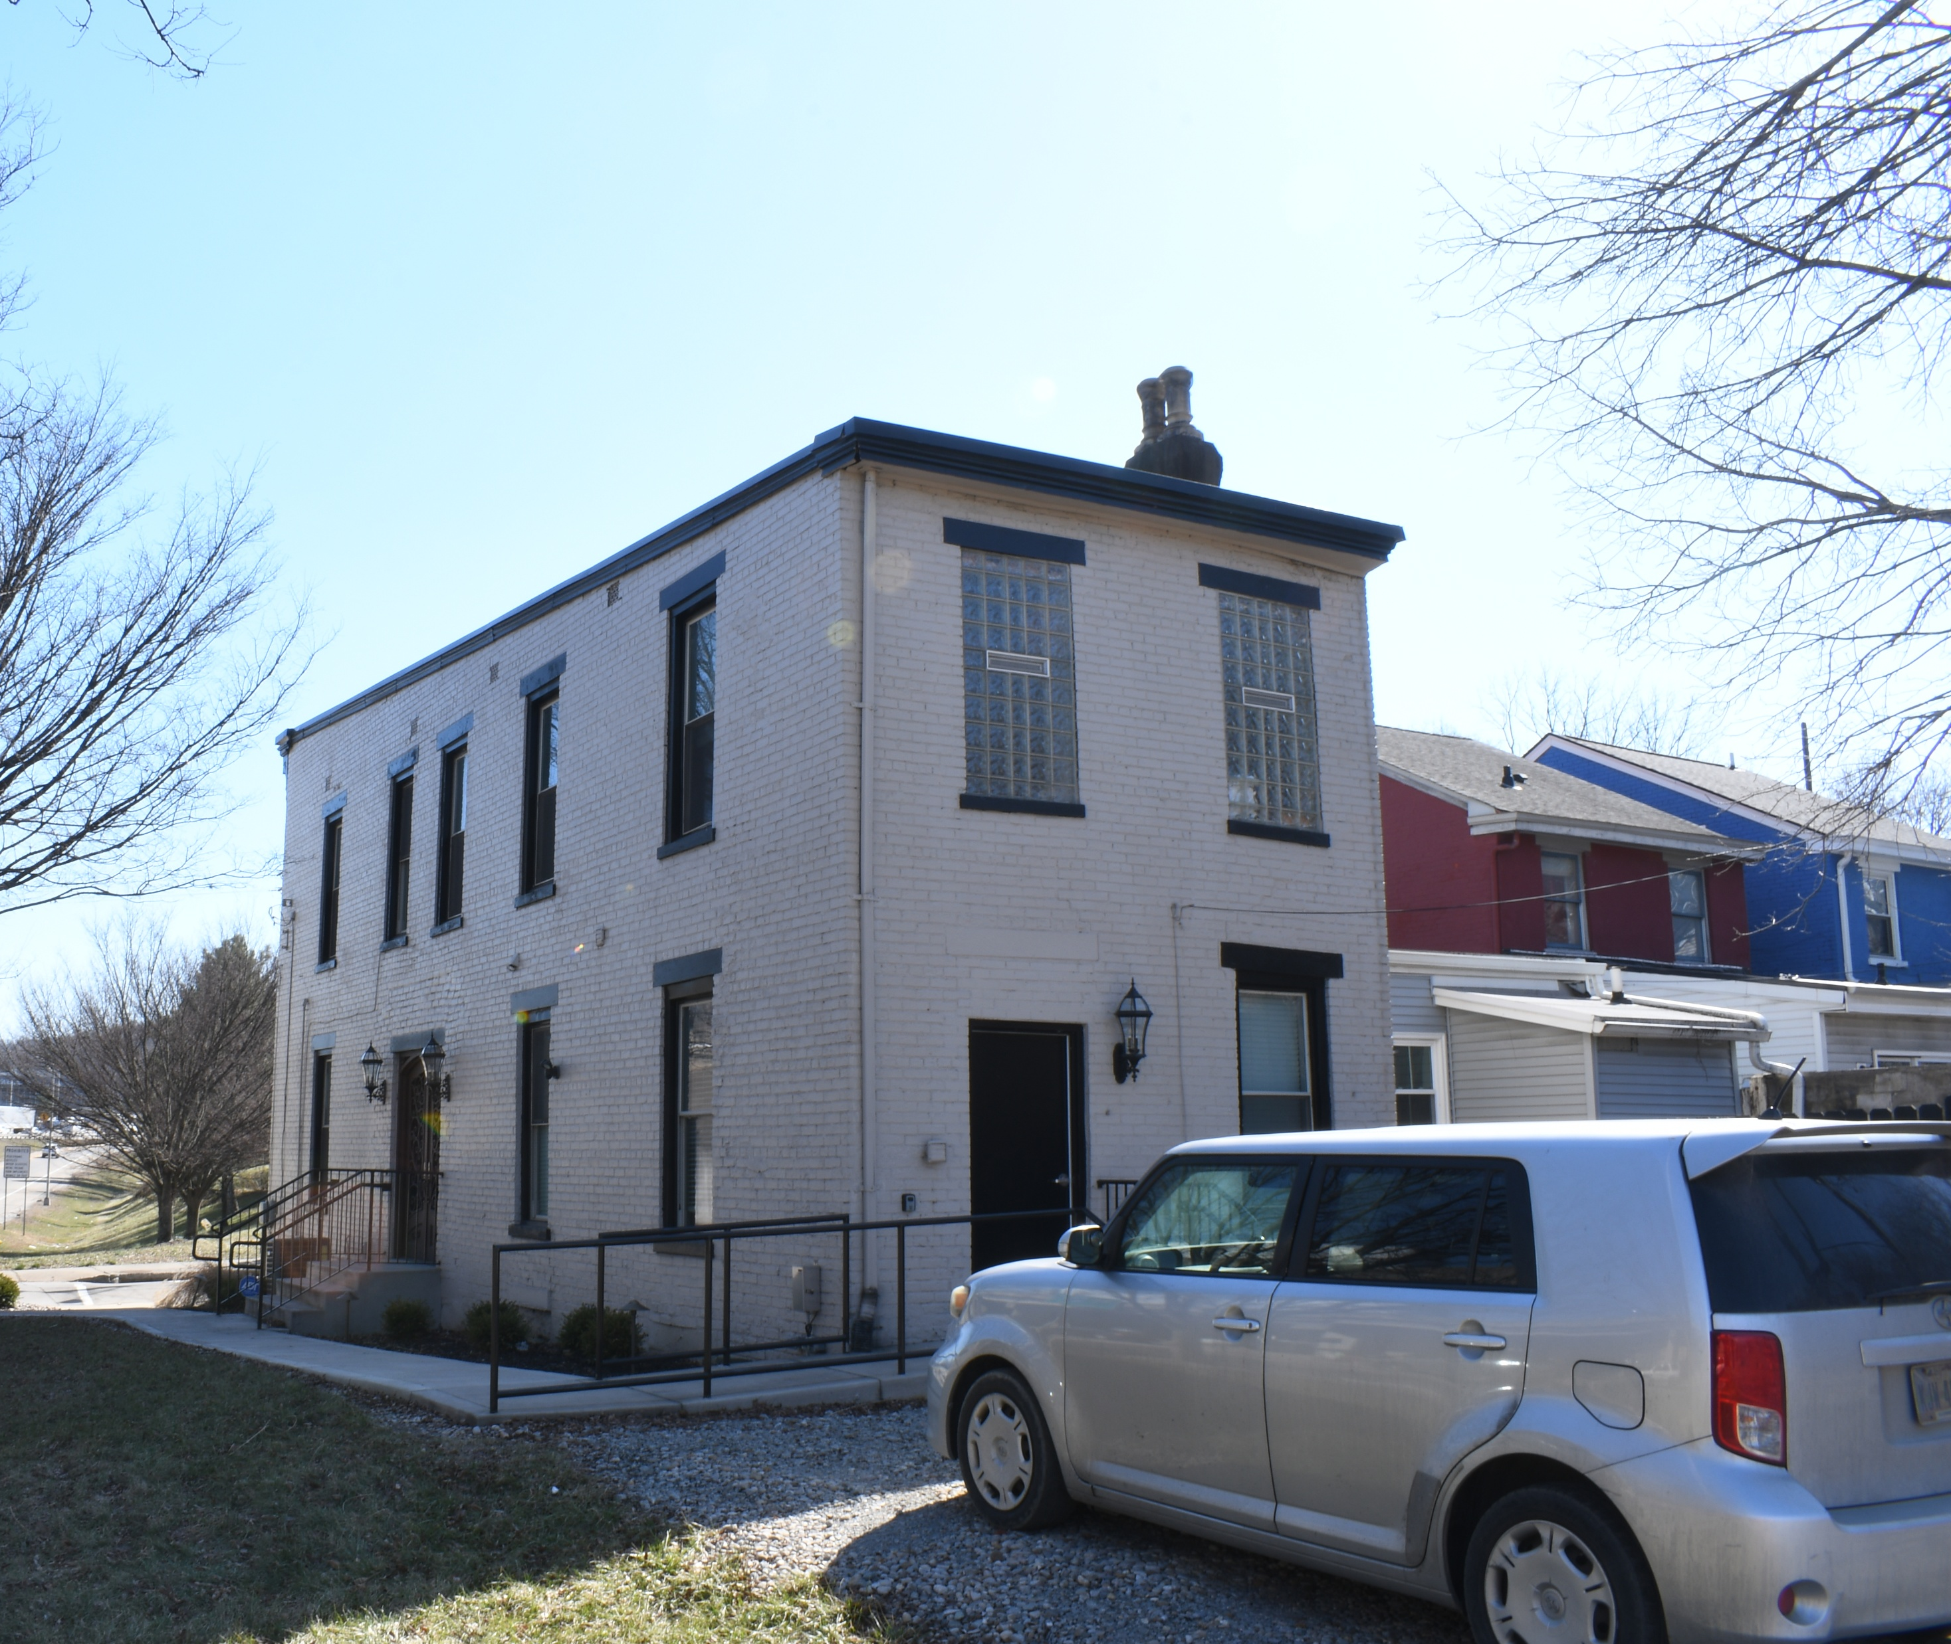
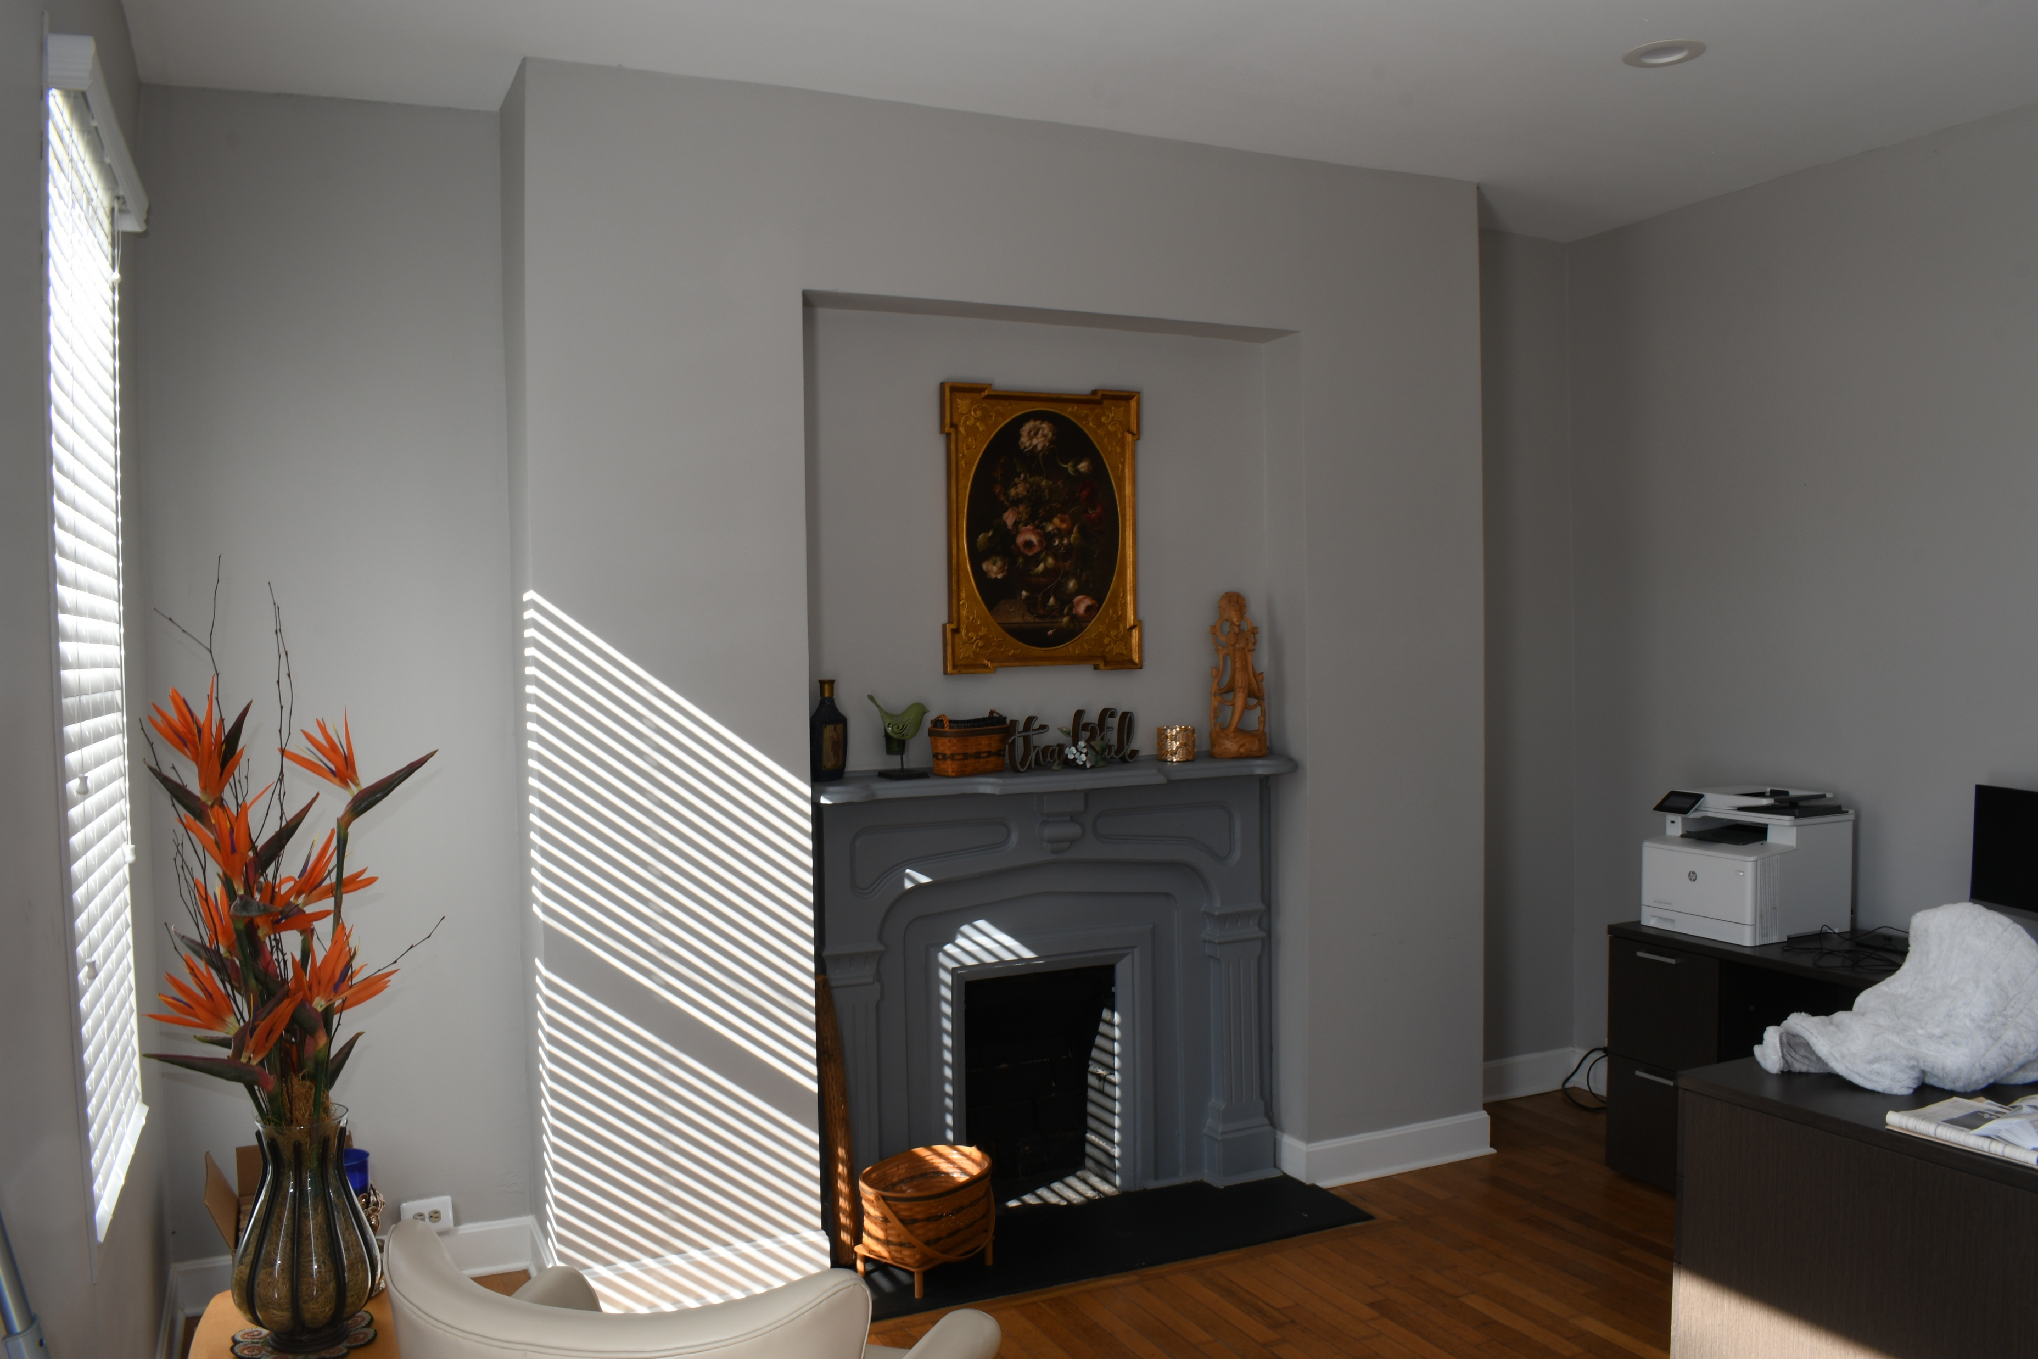
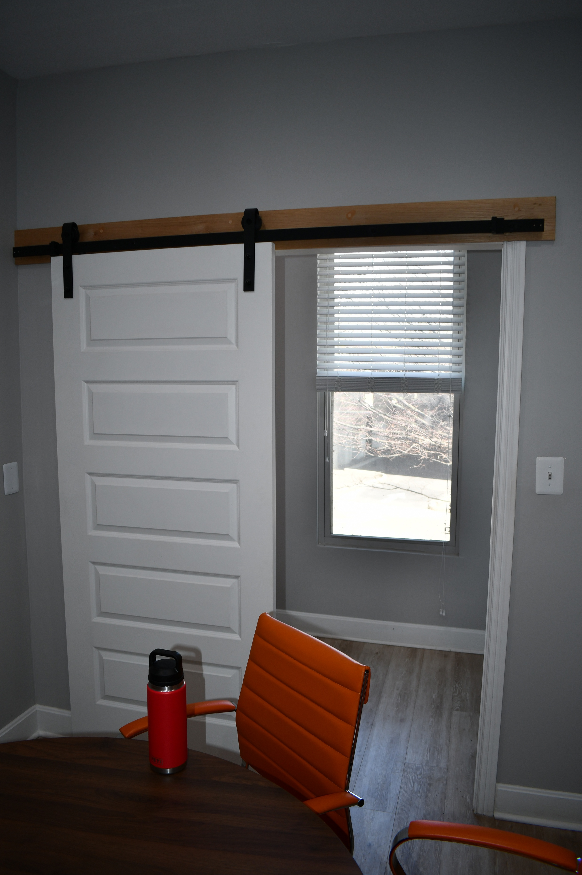
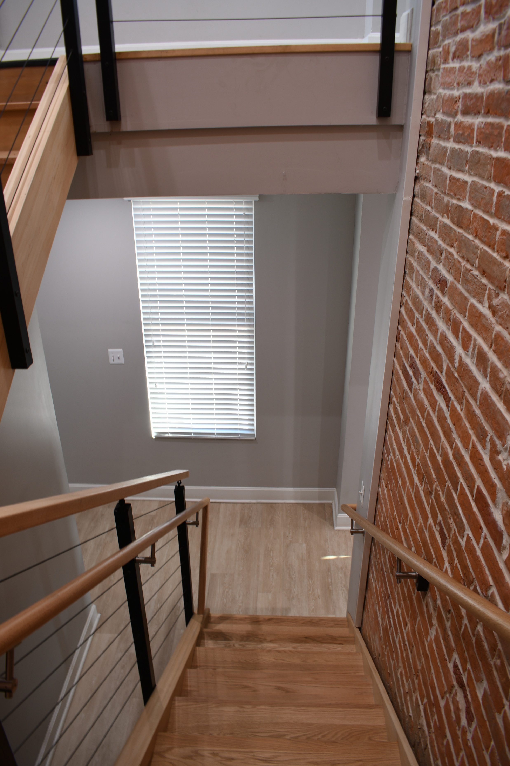
Notes:
604 12th Street had been recently modified to accommodate an office space. All of this was packaged into a report for KYTC and was reviewed and accepted by KY SHPO.
One hard copy of the report is retained by the Kenton County Public Library and one digital copy was provided to the Kentucky Department for Libraries and Archives.

Slide 13
Vibration Monitoring:
Information Needs and Considerations:
What are the existing daily peak particle velocity (PPV) levels for this area?
Has baseline vibration monitoring been conducted to establish daily PPV levels?
Which structures need monitoring?
What are the PPV thresholds for monitored structures?
What types of construction activities will be nearby?
What construction methods will be used and what levels of vibration do they generate?
What information needs to be included in the Vibration Monitoring Plan?
Notes:
Point is to make sure the construction activities do not damage the historic structures with vibrations.
PPV = the accepted method of evaluating the potential for damage

Slide 14
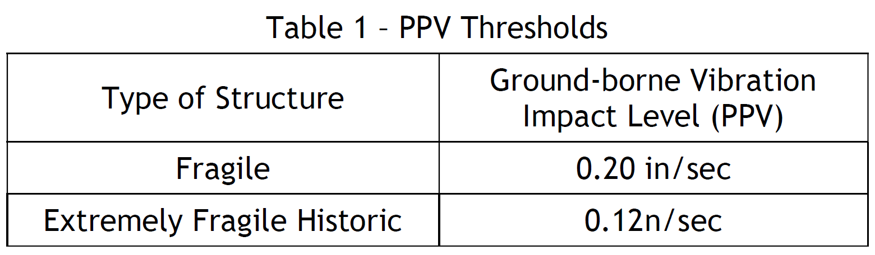
Notes:
This table is directly from the PA and the PPV limits were based on those used by the Louisville Bridges Project in the early 2000s. BUT, there’s no agreed upon definition of Fragile or Extremely Fragile for structures.

Slide 15
Caltrans
Transportation and Construction Vibration Guidance Manual. Available at: https://dot.ca.gov/-/media/dot-media/programs/environmental-analysis/documents/env/tcvgm-apr2020-a11y.pdf
Deutsches Institut für Normung
2016 Vibration in buildings - Part 3: Effects on structures, English translation of DIN 4150-3:2016-12
Federal Transit Administration
Transit Noise and Vibration Impact Assessment (FTA-VA-90-1003-06). Available at: https://www.transit.dot.gov/sites/fta.dot.gov/files/docs/FTA_Noise_and_Vibration_Manual.pdf
Transit Noise and Vibration Impact Assessment Manual (FTA Report No. 0123). Available at https://www.transit.dot.gov/sites/fta.dot.gov/files/docs/research-innovation/118131/transit-noise-and-vibration-impact-assessment-manual-fta-report-no-0123_0.pdf
Harris Miller Miller & Hanson Inc.
Transit Noise and Vibration Impact Assessment. Available at: https://rosap.ntl.bts.gov/view/dot/37722/dot_37722_DS1.pdf
Johnson, Arne P. and W. Robert Hannen
Vibration Limits for Historic Buildings and Art Collections. APT Bulletin/Journal of Preservation Technology 46(2-3): 66-74.
Wilson, Ihrig & Associates, Inc., ICF International, and Simpson, Gumpertz & Heger, Inc.
2012 Current Practices to Address Construction Vibration and Potential Effects to Historic Buildings Adjacent to Transportation Projects (NCHRP 25-25/Task 72). Available at https://onlinepubs.trb.org/onlinepubs/nchrp/docs/NCHRP25-25(72)_FR.pdf
Notes:
This is just a short of list of the references we looked at for discussion of the definitions.

Slide 16
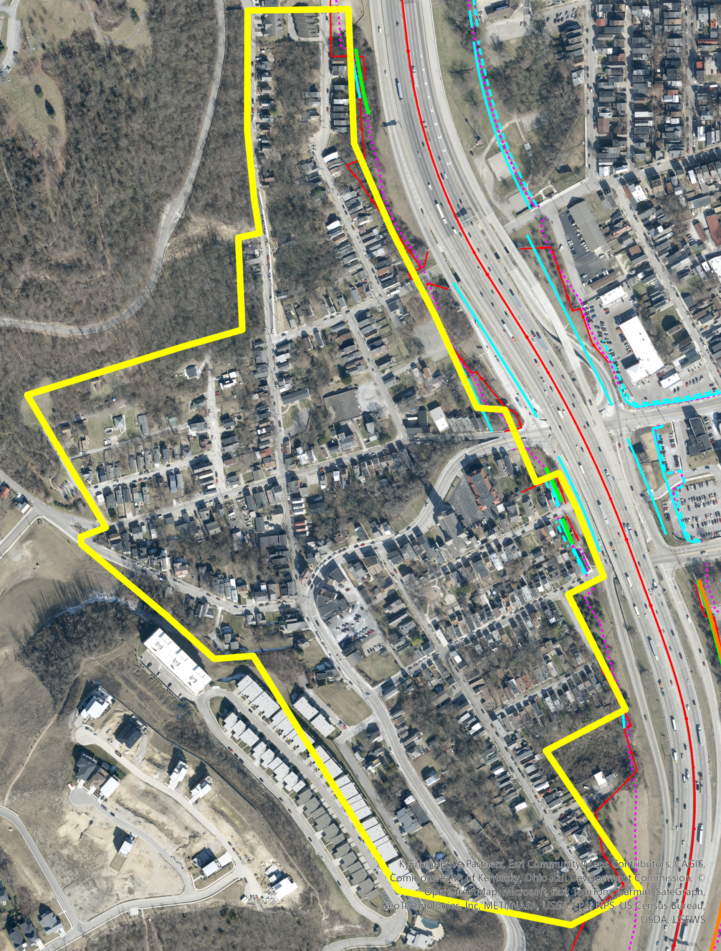

Slide 17
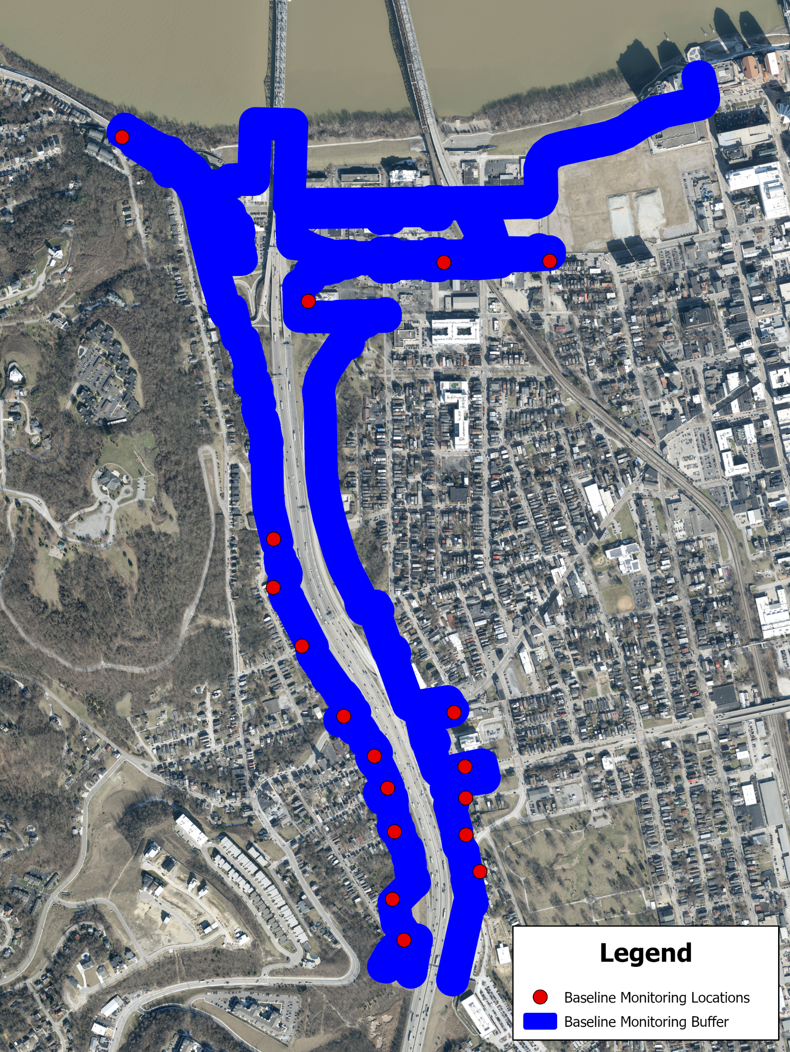
Baseline Monitoring Buffer is the area within 100 feet of the potential disturbance limits that contain historic properties.
Baseline monitoring locations were selected by KYTC and approved by the KY SHPO.
Notes:
The vibration monitoring plans were developed for all areas within 100’ of the potential disturb limits that contain historic structures per the PA.

Slide 18
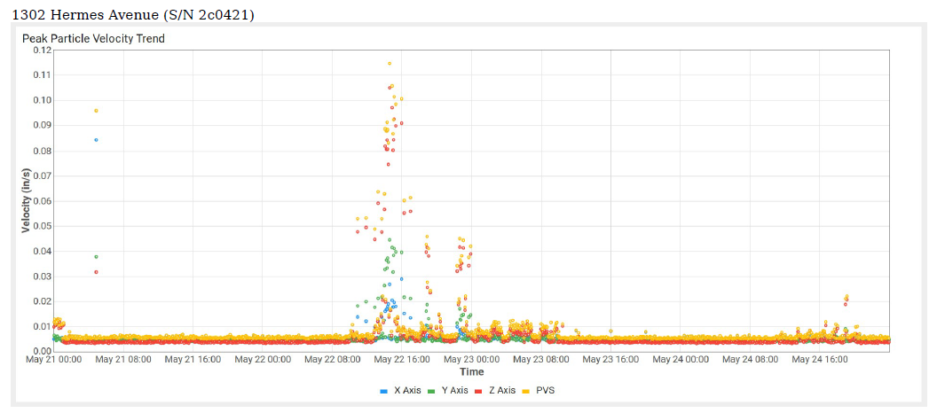
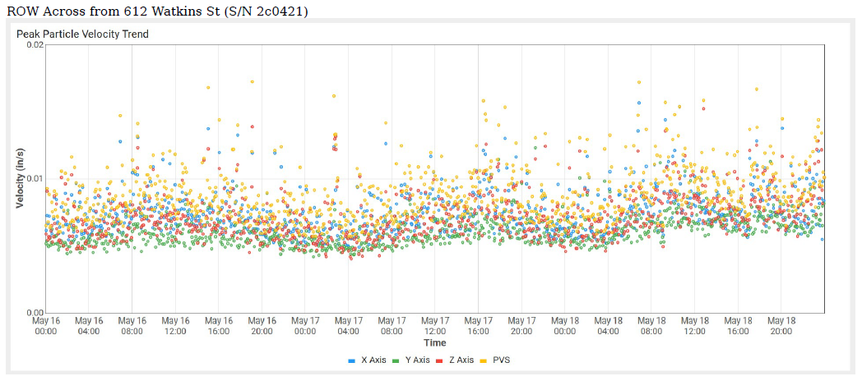
PPV Maximum Values For 1302 Hermes Avenue
Monitoring Dates | X-axis Daily Max Values (in/s) | Y-axis Daily Max Values (in/s) | Z-axis Daily Max Values (in/s)
05/21/2026 - 05/22/2026 | 0.085 | 0.038 | 0.032
05/22/2026 - 05/23/2026 | 0.029 | 0.045 | 0.105
05/23/2026 - 05/24/2026 | 0.009 | 0.009 | 0.011
05/24/2026 - 05/24/2026 | 0.007 | 0.009 | 0.021
PPV Maximum Values For ROW Across from 612 Watkins St
Monitoring Dates | X-axis Daily Max Values (in/s) | Y-axis Daily Max Values (in/s) | Z-axis Daily Max Values (in/s)
05/16/2026 - 05/17/2026 | 0.006 | 0.009 | 0.014
05/17/2026 - 05/18/2026 | 0.023 | 0.012 | 0.013
05/18/2026 - 05/18/2026 | 0.007 | 0.011 | 0.015
Notes:
The vibration monitoring was conducted by DRW Associates over the course of several weeks. Here are the results for 2 of the baseline locations, both are in the Lewisburg HD. These all fell below the PPV thresholds for both the fragile and extremely fragile structure types.

Slide 19
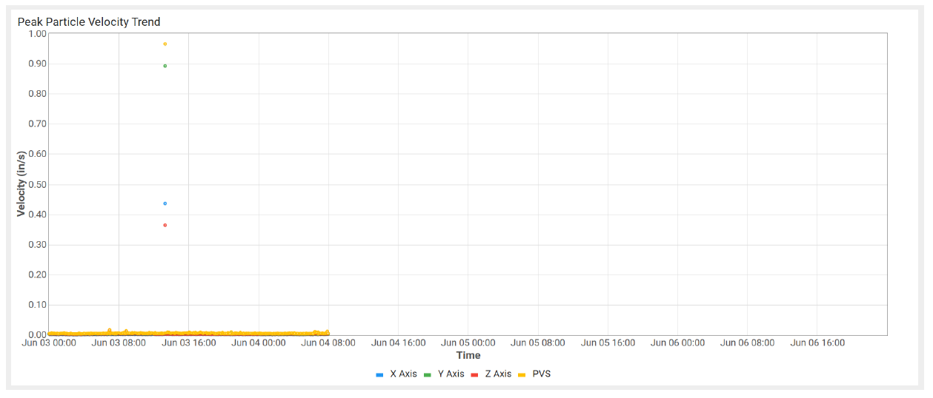
WK KY K (510 Prague St) Monitoring Location
PPV Maximum Values For WK KY K (510 Prague St)
Monitoring Dates | X-axis Daily Max Values (in/s) | Y-axis Daily Max Values (in/s) | Z-axis Daily Max Values (in/s)
06/03/2026 - 06/04/2026 | 0.438 | 0.892 | 0.366
06/04/2026 - 06/05/2026 | 0.011 | 0.006 | 0.012
Notes:
There was one location that did exceed the thresholds during the baseline evaluations and hit 0.892, 0.438, and 0.366 PPV. It’s unclear exactly what exactly triggered the spike since it’s a residential location, so it’s possible that somebody bumped it or ran a lawn mower right next to it.

Slide 20
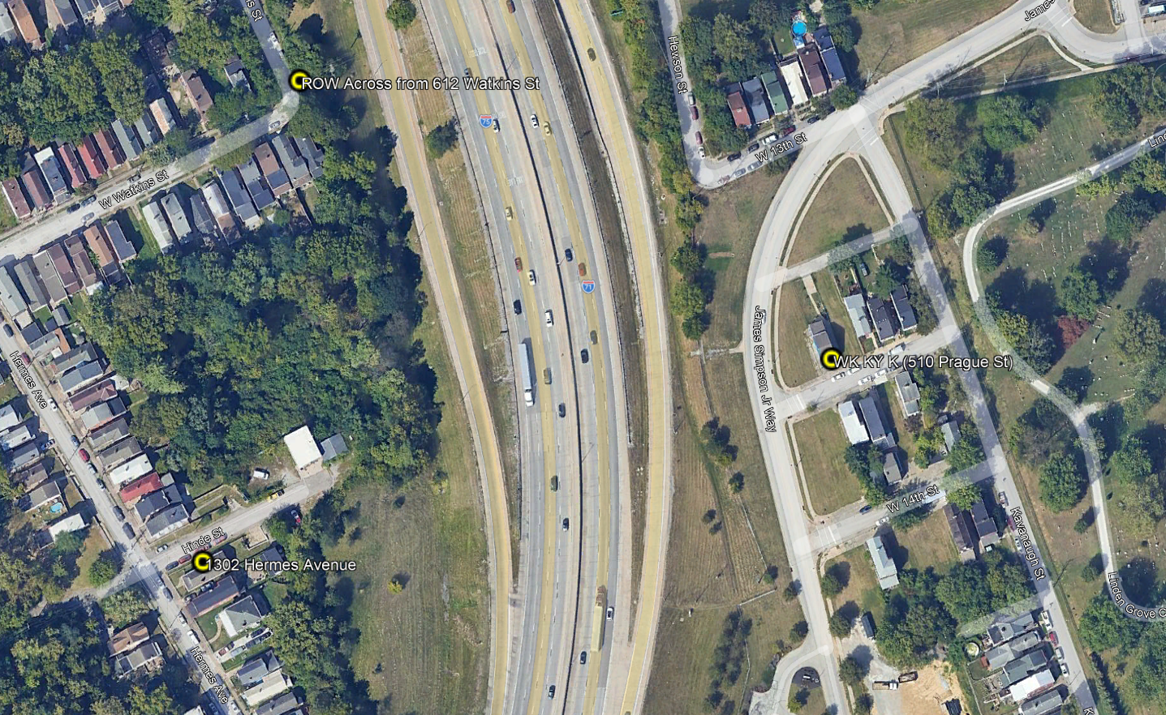

Slide 21
CONSTRUCTION VIBRATION MONITORING
From Section 106 PA Requirements to
Construction Execution
Jared Bloom, Environmental Compliance Coordinator
Walsh Kokosing Joint Venture
Prediction • Planning • Field Monitoring • Response
Notes:
Opening: This presentation follows the vibration-monitoring process from a construction perspective — from PPV requirements through field response.

Slide 22
PPV Limits Can Change How We Build
The PA requirements become a construction planning constraint..
SECTION 106 PPV LIMIT
CONSTRUCTION METHOD
FIELD EXECUTION
MEASURED RESULT
Concrete Pavement Removal
Full-power MHB operation was predicted to exceed the applicable PPV limit.
Wall Installation
ICE 44-65 vs. ICE 66C depends on field conditions; planning uses the more conservative radius.
Key idea: vibration criteria can affect equipment selection, operating parameters, and means & methods before work begins.
Notes:
Explain that the PA requirements can affect actual means and methods. Use pavement breaking and wall installation as examples.

Slide 23
From Equipment to a Vibration Heat Map
Predict the radius of influence before the work reaches the field.
Construction
Activity
FTA
Methodology
Reference PPV
at 25 ft
Radius of
Influence
KMZ
Heat Map
Impact Pile Driving
96 ft
Concrete Pavement Breaking
41 ft
Walls & Retaining Walls
59 ft
Low Vibration Activities
13 ft
Conservative assumptions were used for key equipment; the KMZ layers can be turned on/off by vibration category.
Notes:
Explain the FTA-based prediction process and show the actual KMZ/heat map

Slide 24
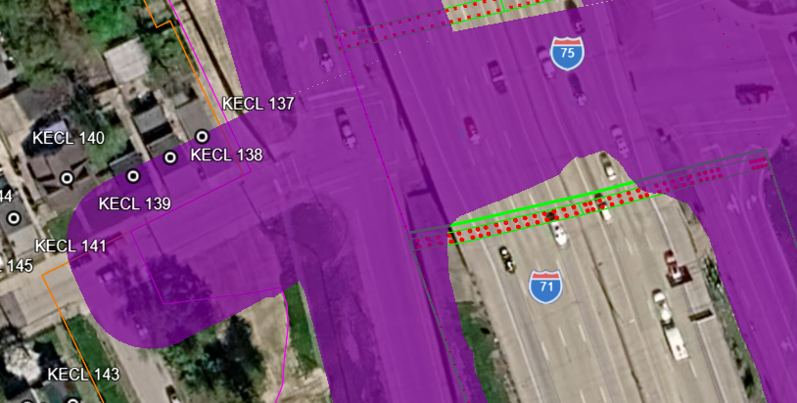

Slide 25
The Heat Map Becomes a Construction Planning Tool
The KMZ is reviewed against the three-week schedule—not just filed with the plan.
Three-week
Schedule
Where are we
working?
What vibration
activity?
Which receptors
are affected?
Where do monitors
need to go?
Review current monitor locations and whether they remain in the vibration transmission path.
Overlay upcoming work locations with the high / medium / low vibration layers.
Consider receptor susceptibility and the applicable monitoring requirements.
Coordinate proposed locations with the vibration monitoring subcontractor.
Target installation at least 72 hours before work when practical.
The goal is to have monitoring in place before the equipment arrives.
Notes:
Walk through how the three-week schedule drives monitoring decisions and how existing monitors are checked against the vibration transmission path.

Slide 26

Putting the Monitor in the Right Place
The receptor has the PPV limit; the monitor must represent what the receptor experiences..
Inzwa Veva III
RECEPTOR PPV LIMIT
MONITOR LOCATION
Preferred: direct attachment to the foundation using a bolt.
Historic structures: direct attachment is not approved.
Alternative: bury the device approximately 6–8 inches.
Placement is selected to be in the direct transmission path.
If the monitor is directly on/adjacent to the receptor foundation:
Monitor alert threshold = receptor PPV threshold
If the monitor is offset:
Attenuation between source → monitor → receptor is considered to establish a monitor-specific alert threshold.
The receptor PPV limit does NOT change.
Notes:
Explain why monitor placement matters and why an offset monitor may require a different alert threshold even though the receptor PPV limit stays the same.

Slide 27
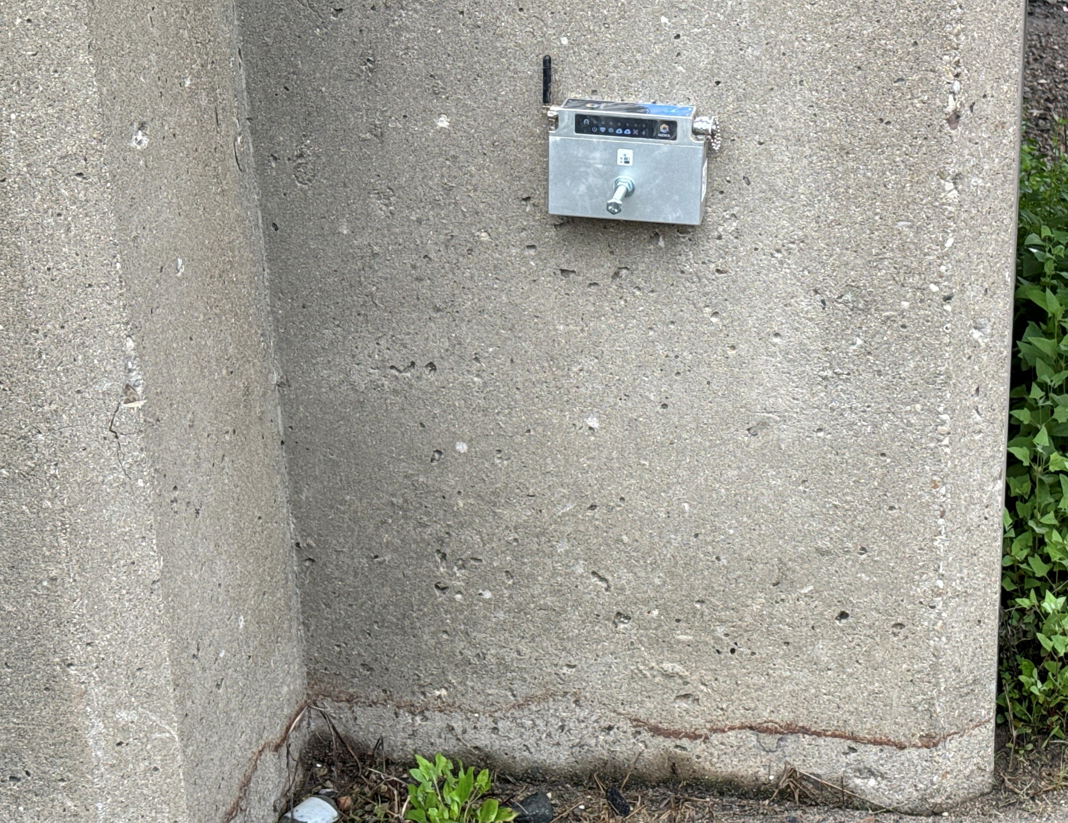

Slide 28
What Happens When Construction Starts?
Real-time data turns the monitoring plan into an active construction control..
Install & Verify
Establish
Baseline
Construction
Starts
Real-time
PPV
Alert & Act
~72 hours
Ambient Conditions
Dashboard updated within seconds.
90% Warning
WK and Project Ownership have real-time access to vibration data through the online dashboard.
SMS and email alerts are available when limits are exceeded.
A 90% alert provides an opportunity to investigate and intervene before an actual exceedance.
Notes:
Describe the field workflow: installation, baseline, work, dashboard, 90% warning, and response.

Slide 30
When the Number Turns Red
An exceedance is the start of an investigation—not the end of the process.
0.21 in/sec
0.20 in/sec LIMIT
STOP WORK
Superintendent / Environmental Monitor / monitoring subcontractor stops the work.
Review equipment and work activities occurring at the time of the event.
Compare against baseline data and other site operations.
Determine whether the vibration was attributable to construction.
Implement corrective action or change means & methods before resuming.
Attribution matters: nearby utility work or normal public activity can also create vibration at a monitor.
Notes:
Use the 0.21 vs. 0.20 example to make the response process concrete. Emphasize attribution and baseline review.

Slide 31
Monitoring Beyond Section 106
WK uses vibration data as a broader construction risk-management tool..
Historic properties within the applicable Section 106 requirements
Existing and new project elements (bridges, walls, utilities, and non-historic houses
Preconstruction condition documentation
Evaluation of future means & methods
Equipment selection
SECTION 106
≈100 FT
WK BROADER RISK MANAGEMENT
≈140–160 FT
Can we use piles?
What pile diameter / hammer is appropriate?
Do we need drilled shafts?
Do we need multiple pieces of equipment?
Notes:
Explain the broader risk-management use of data beyond Section 106, including non-historic structures and future means-and-methods decisions.

Slide 32
Lessons Learned
The strongest monitoring programs connect environmental requirements directly to construction planning.
01
Coordinate Early
Bring construction, environmental, owner, monitoring, and other stakeholders together before work begins.
02
Make Requirements Actionable
Clearly document what the Section 106 language means for construction and monitoring.
03
Use Data to Build Better
Compare predicted and actual vibration and use the results to improve future means & methods.
04
Future 106 Consulting
Compare current requirements, agency expectations, and actual results to improve future project.
Bottom line: monitoring is most valuable when it helps the construction team safely perform the work—not simply when it produces a report.
Notes:
Close with the four lessons learned and the central message: monitoring should inform construction decisions.

